Slide 1

React
By : Ashish Kumar Patel

Slide 2
Getting Started

Slide 3
What is React?
And Why Would
We Use It?

Slide 4
What is React?
A JavaScript Library for building User Interfaces
User Interfaces are the combination of Component
User code once for component and use as many as time you want.

Slide 5
Real-World SPAs & React Web Apps
www.reactjs.org
www.netflix.com

Slide 6
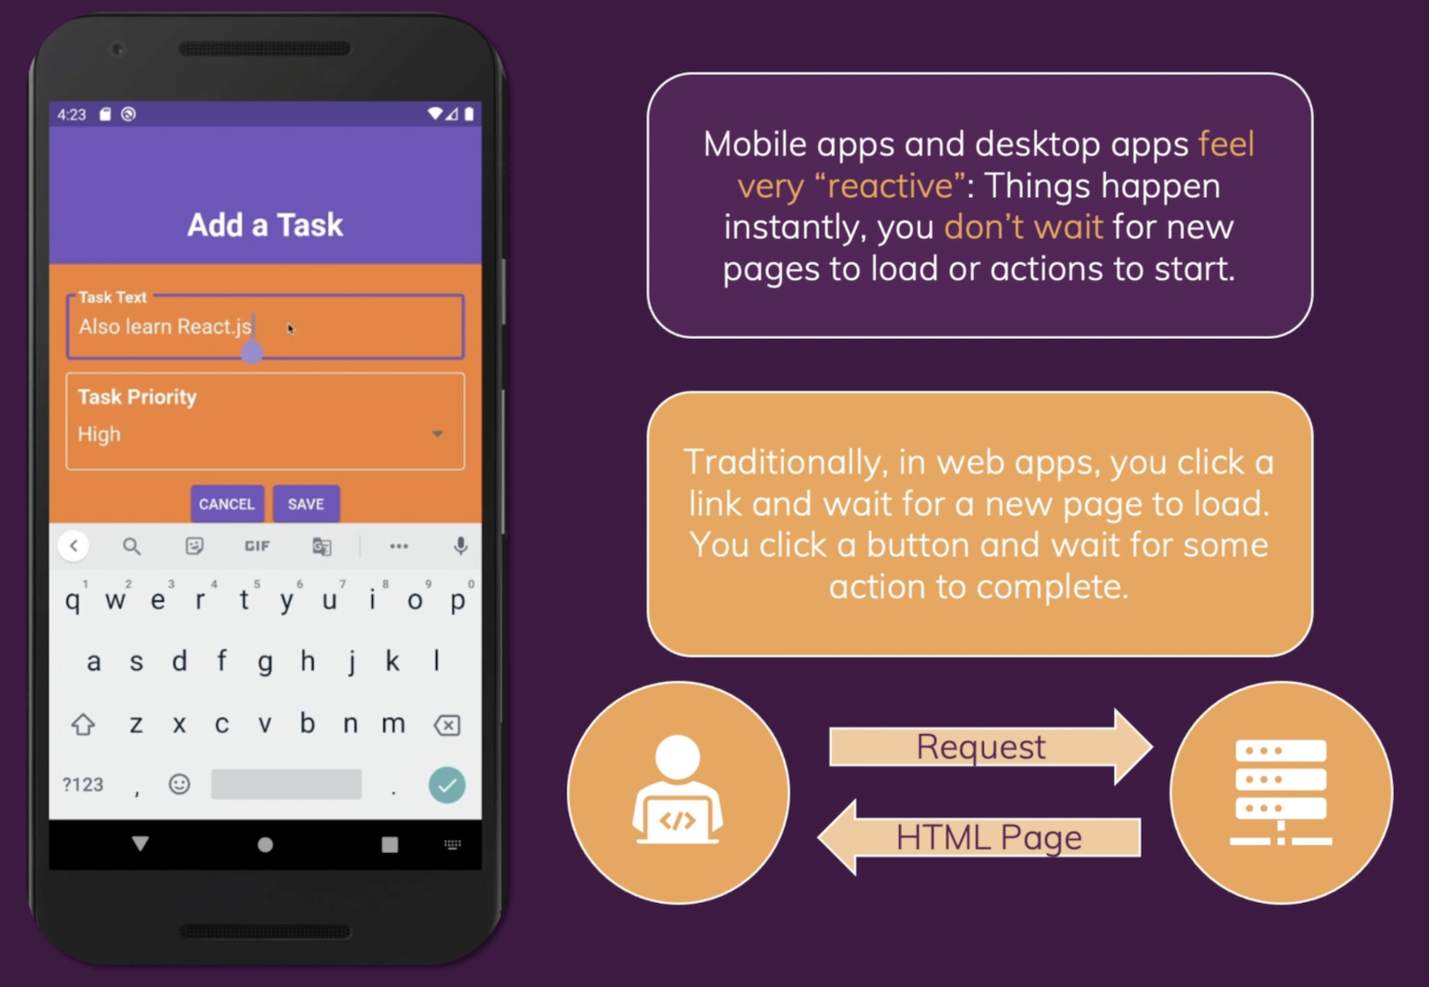

Slide 7
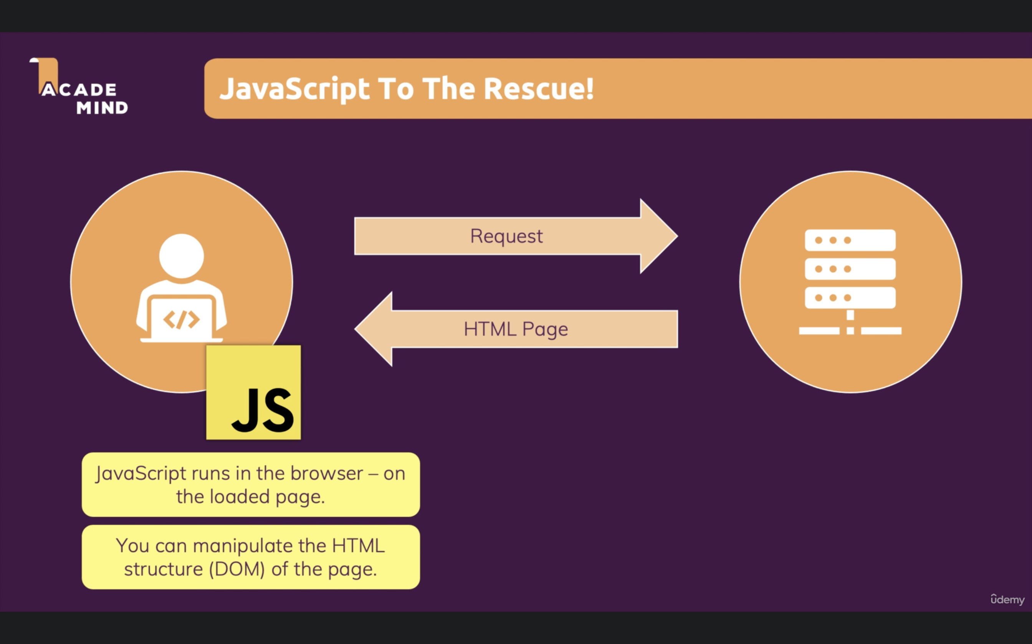

Slide 8
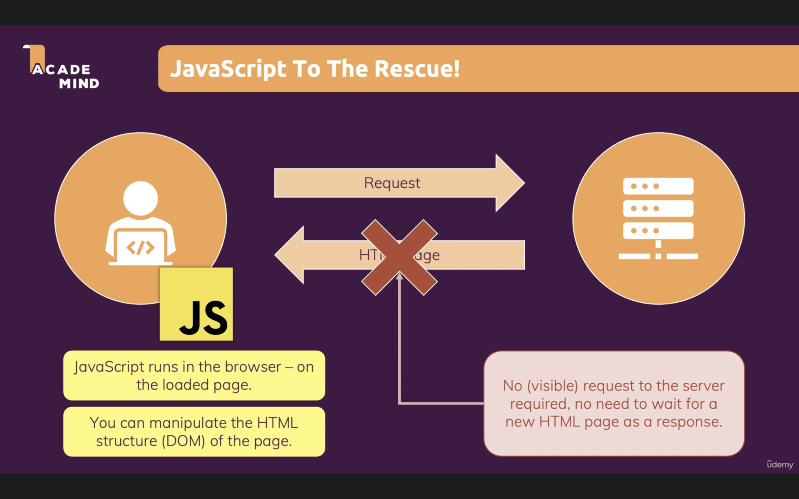

Slide 9
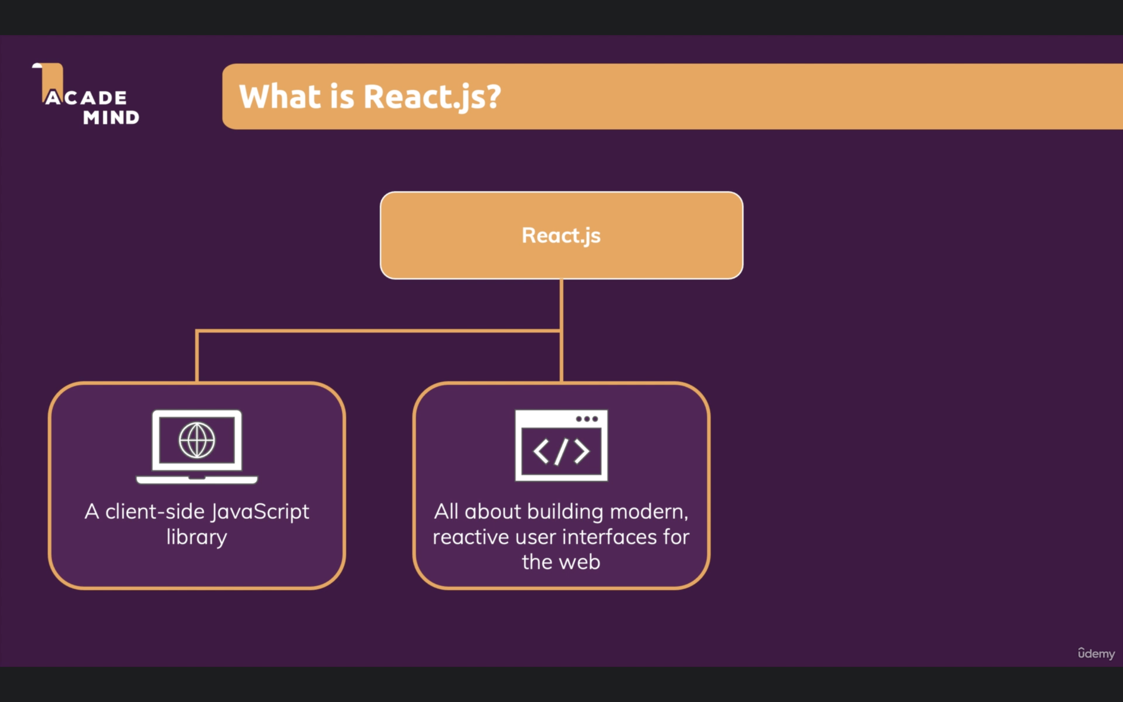

Slide 10
Why React Instead Of “Just JavaScript”

Slide 11
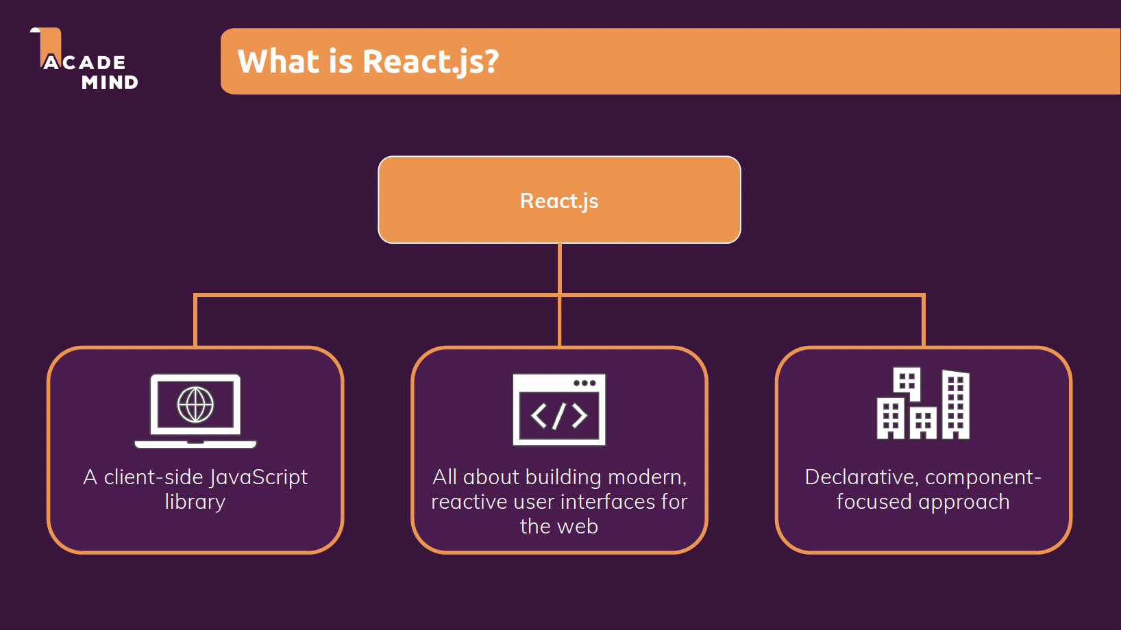

Slide 12
Lets run the example code
Just JS
React

Slide 13
Building Single-Page Applications (SPAs) with React

Slide 14
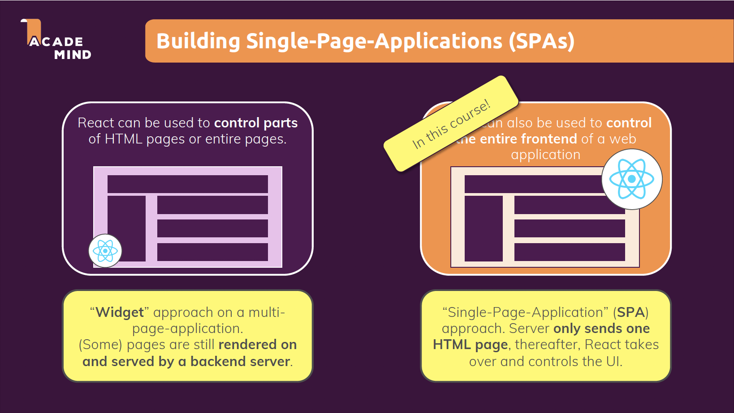

Slide 15
Exploring React.js vs Alternatives (Angular/Vue)

Slide 16
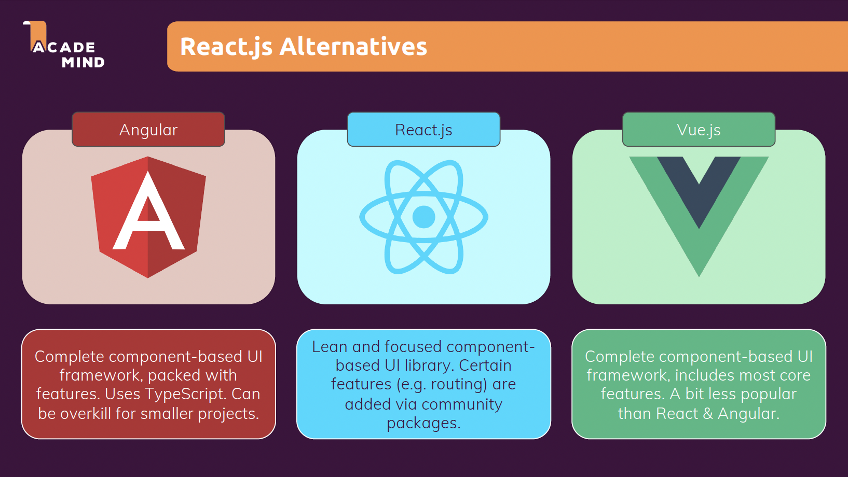

Slide 17
Code Editor

Slide 18
Code Editor
Video Studio Code (https://code.visualstudio.com/)
WebStorm(https://www.jetbrains.com/webstorm/)
Sublime (https://www.sublimetext.com/)

Slide 19
React Basics & Working with Component

Slide 20
React Basics & Working with Component

Slide 21
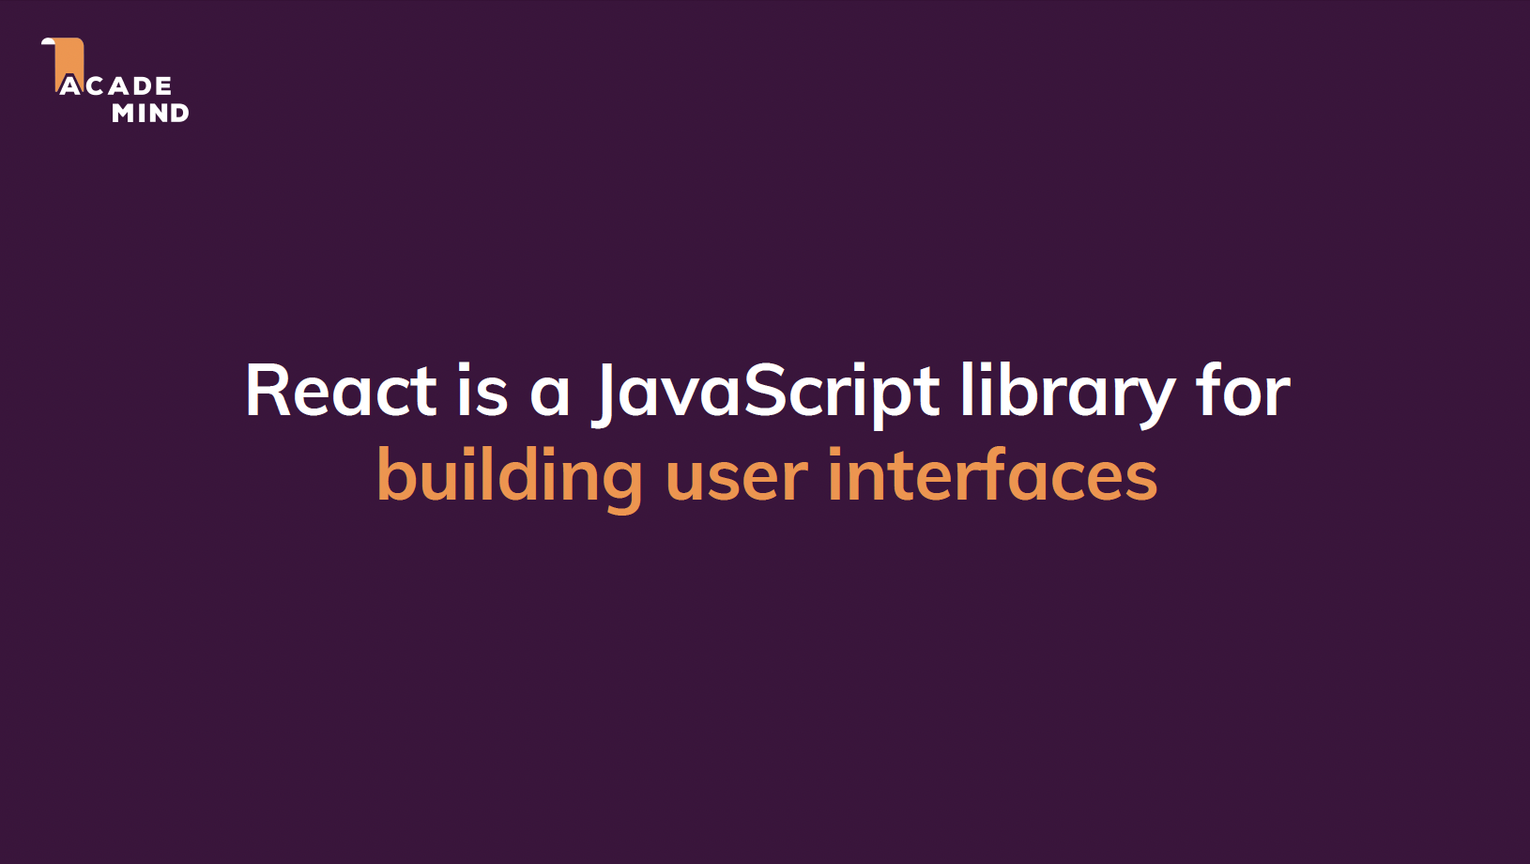

Slide 22
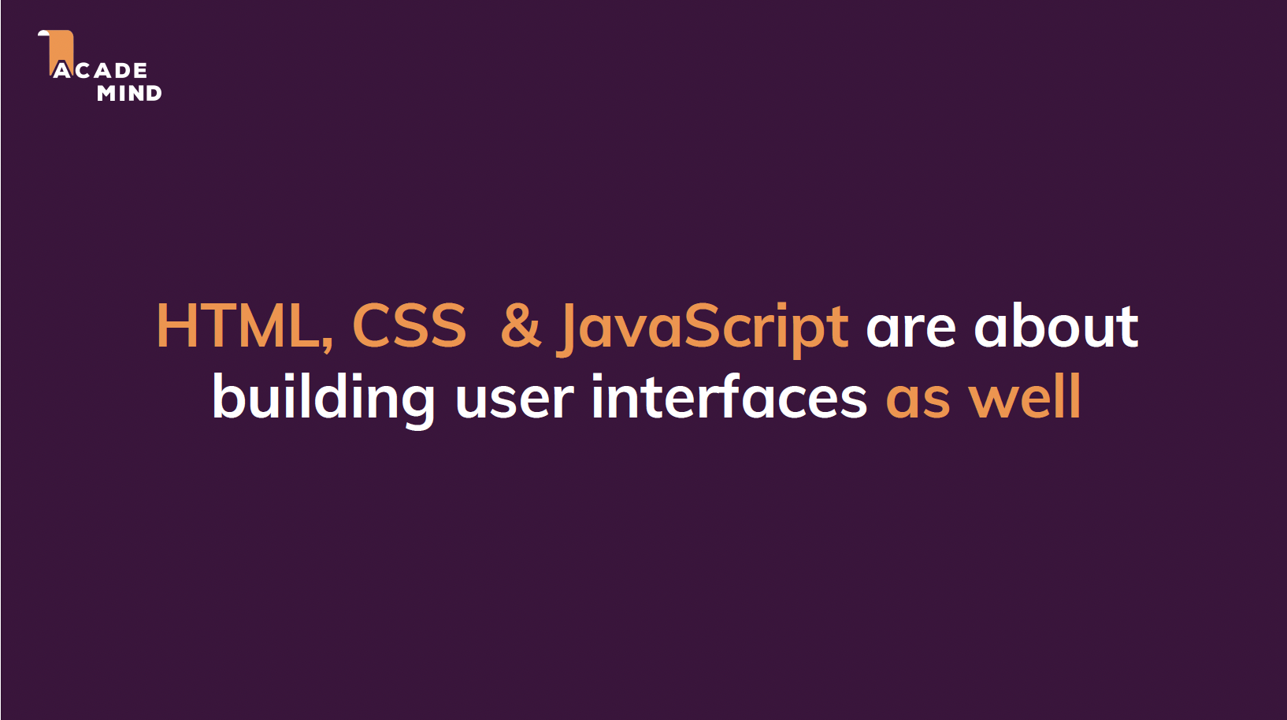

Slide 23
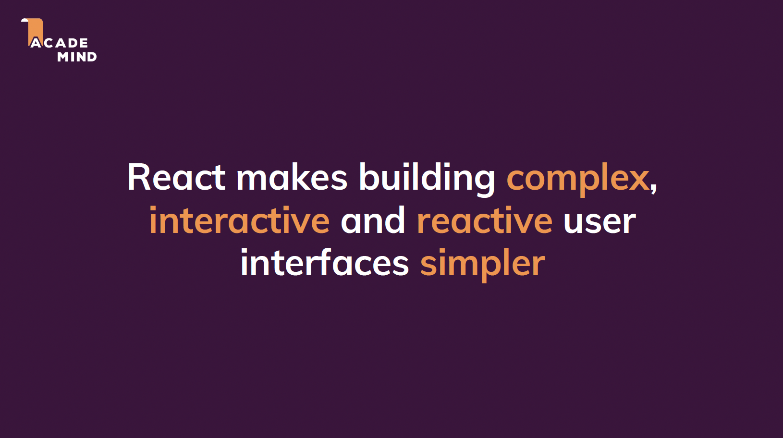

Slide 24
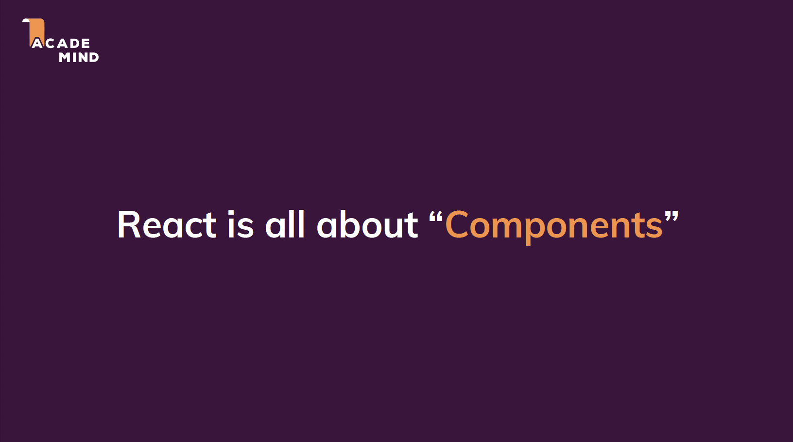

Slide 25
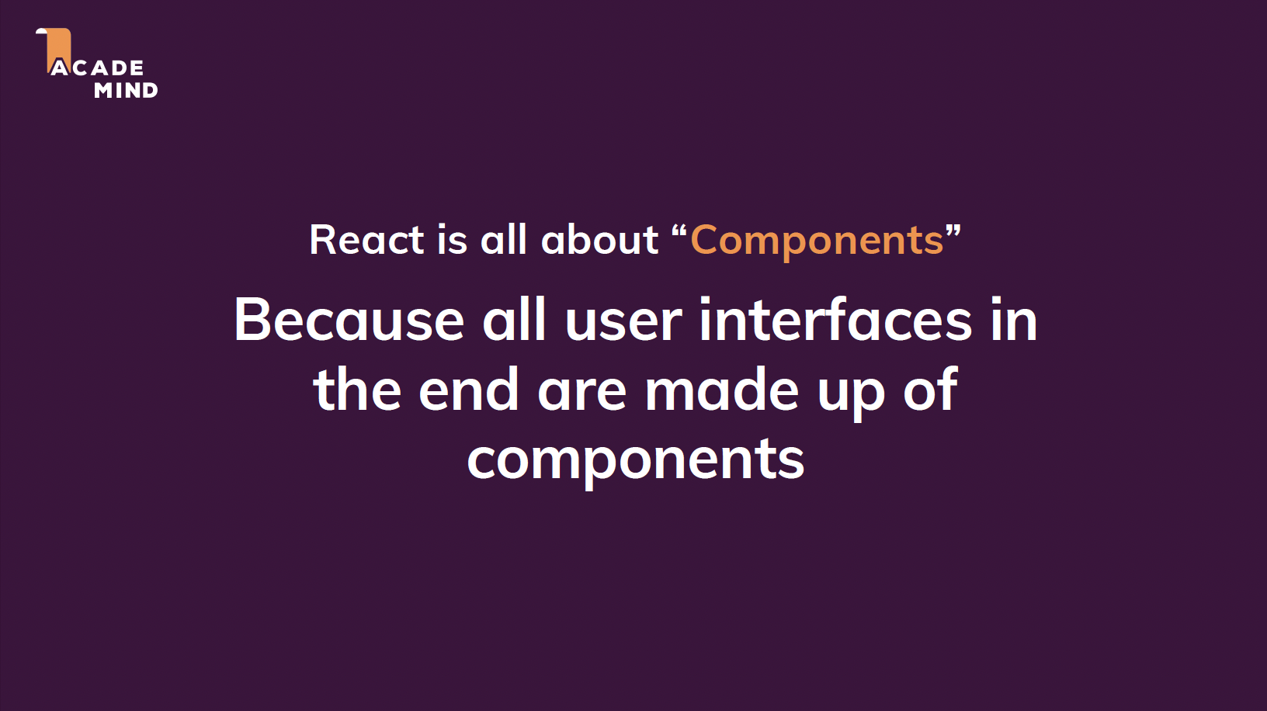

Slide 26
React Code Is Written In A “Declarative Way”

Slide 27
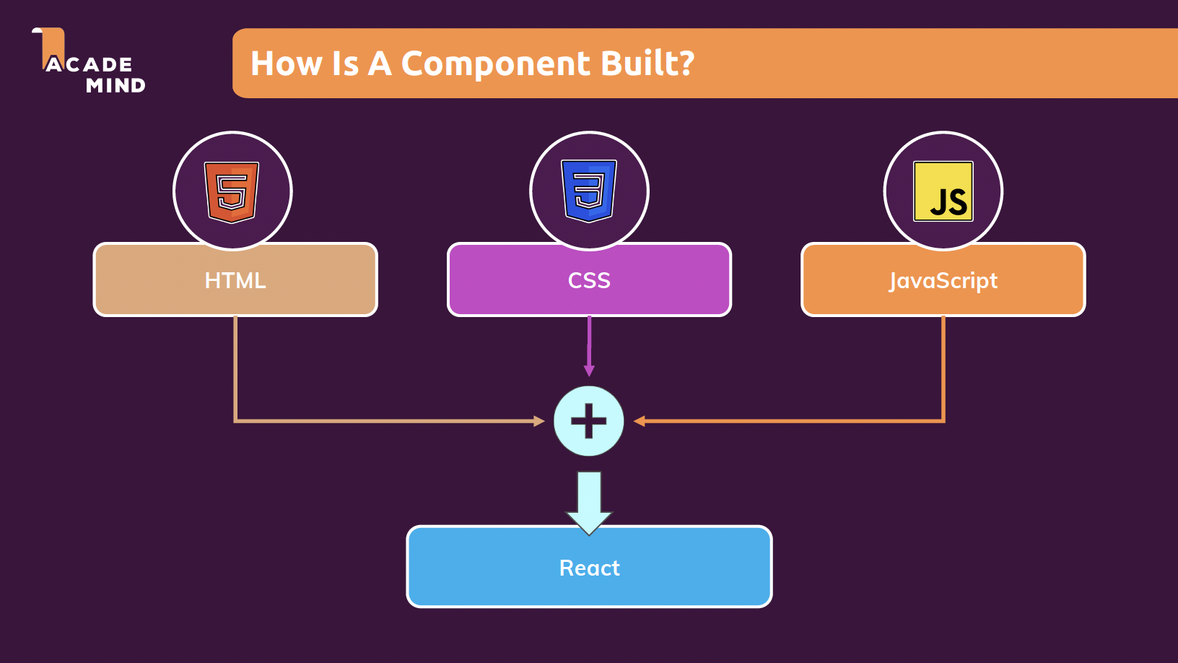

Slide 28
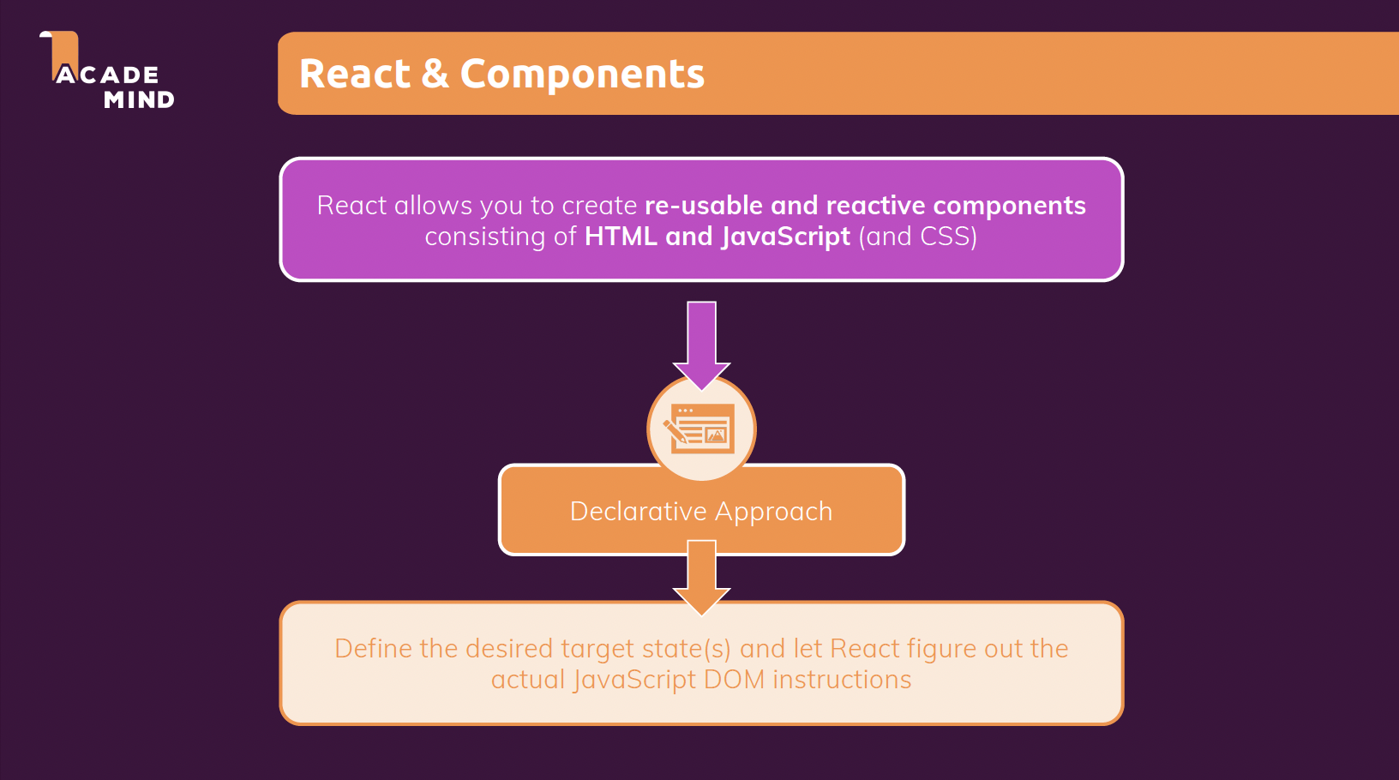

Slide 29
Let’s Create a New Project in React

Slide 30
Writing our First React App
https://reactjs.org/docs/create-a-new-react-app.html
https://nodejs.org/en/

Slide 31
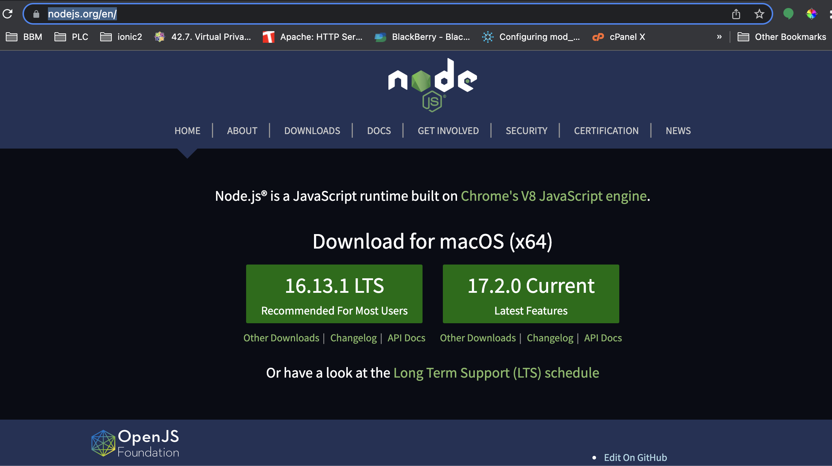

Slide 32
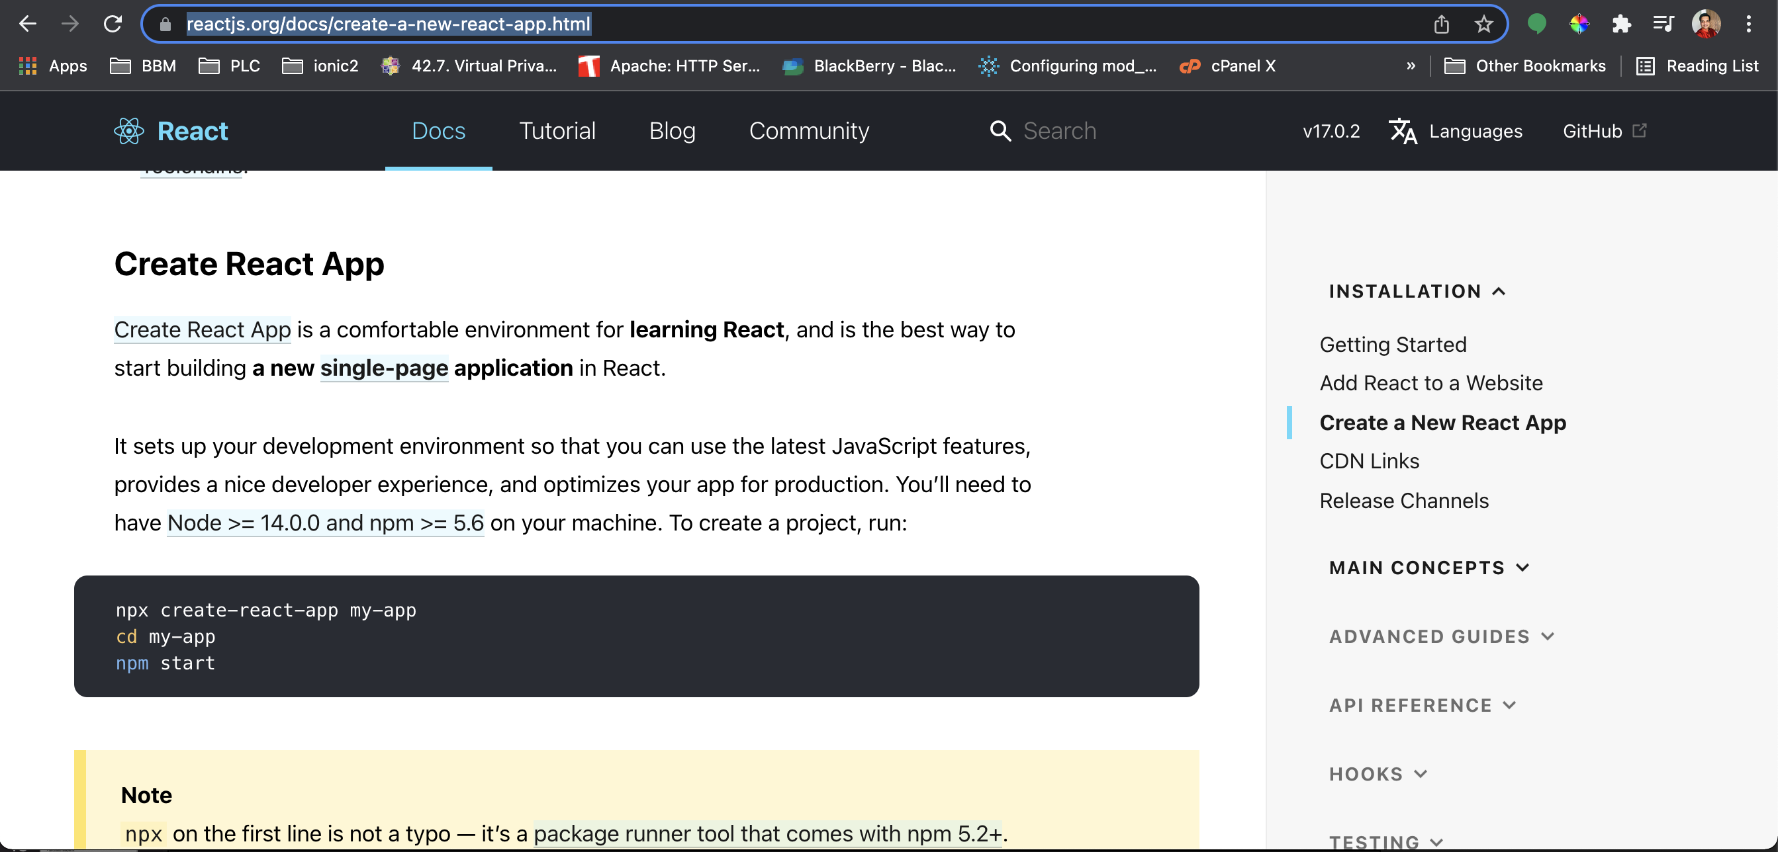

Slide 33
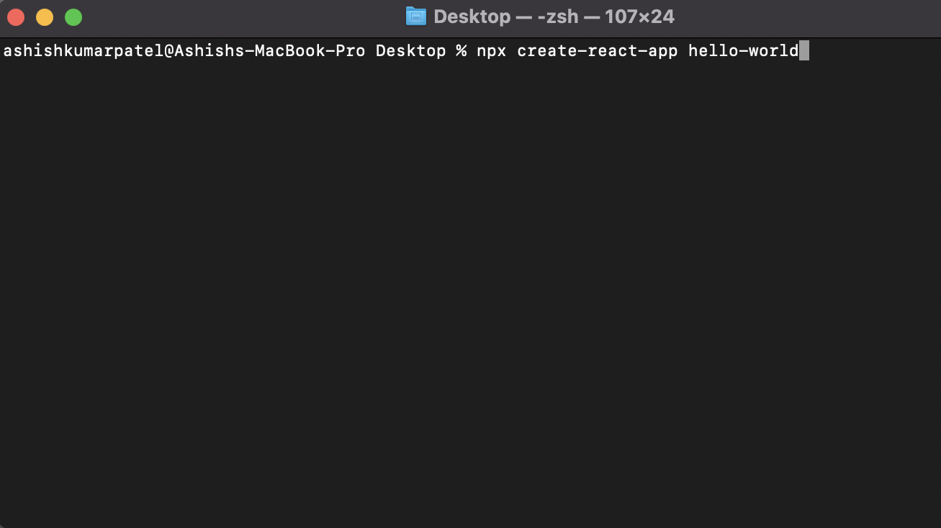

Slide 34
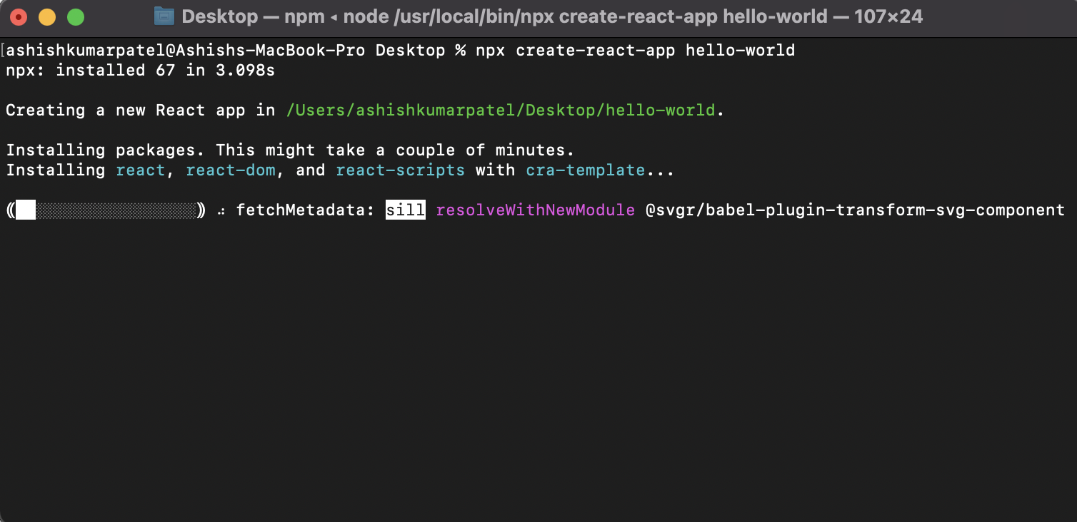

Slide 35
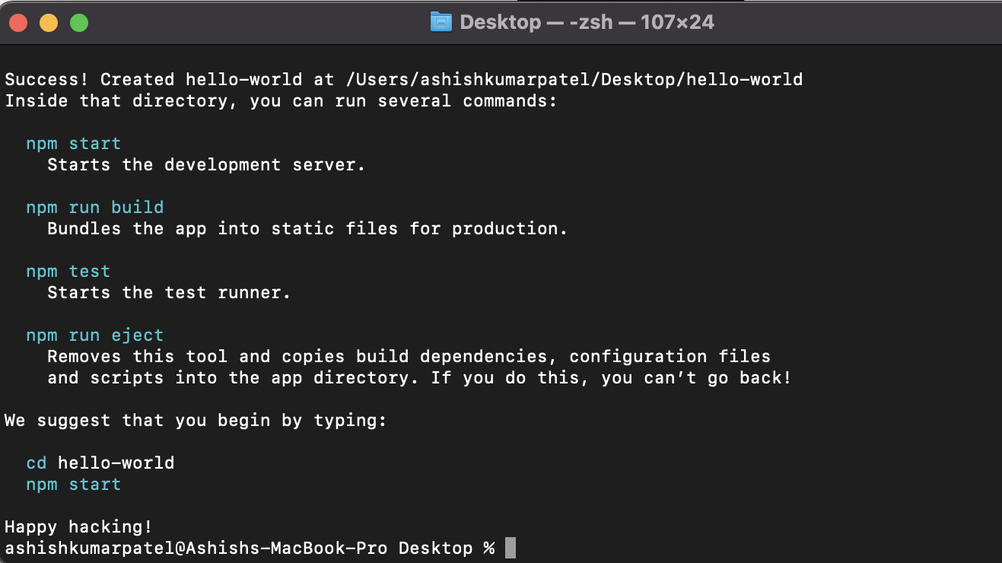

Slide 36
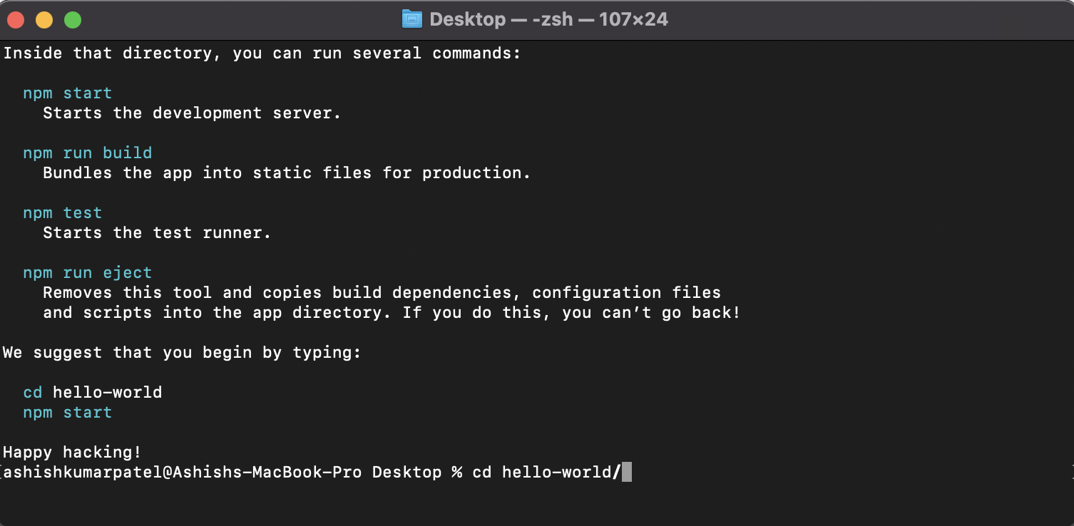

Slide 37
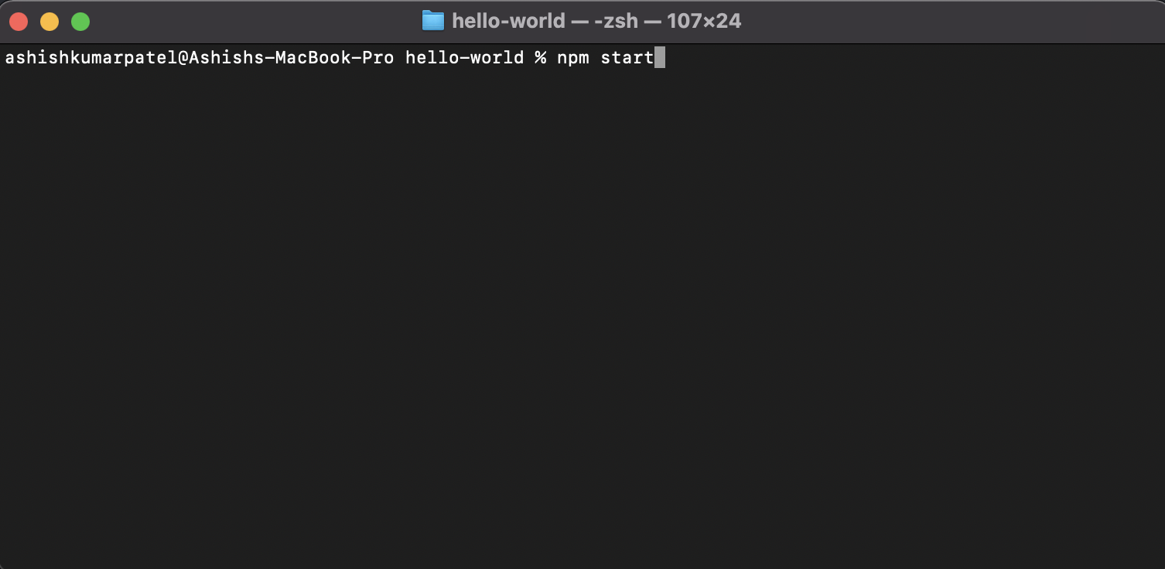

Slide 38
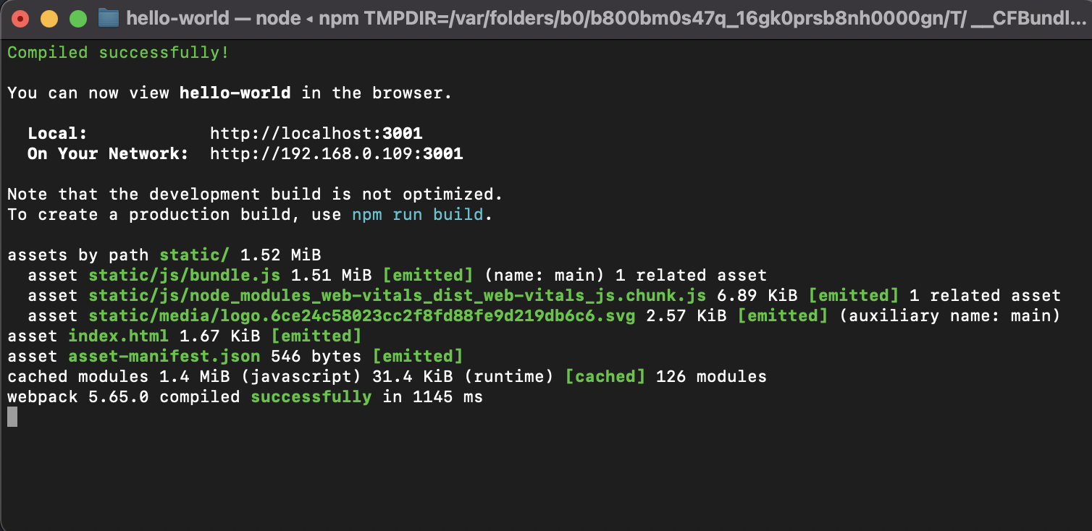

Slide 39
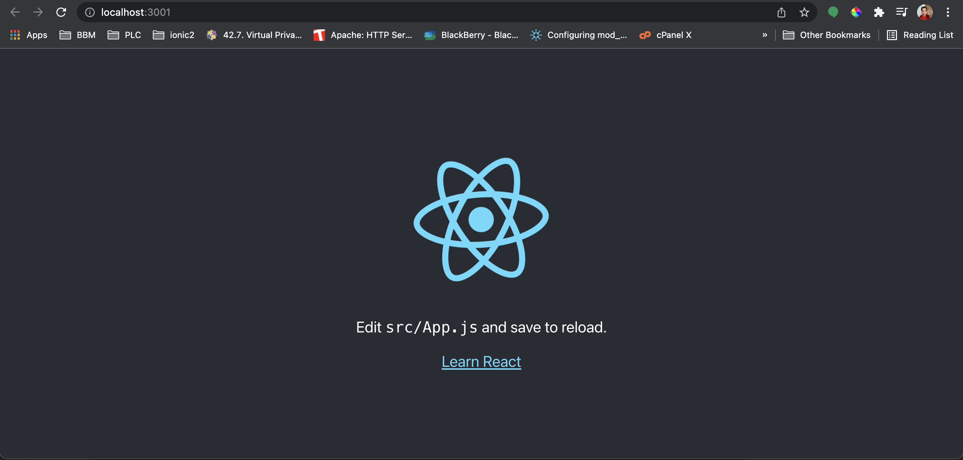

Slide 40
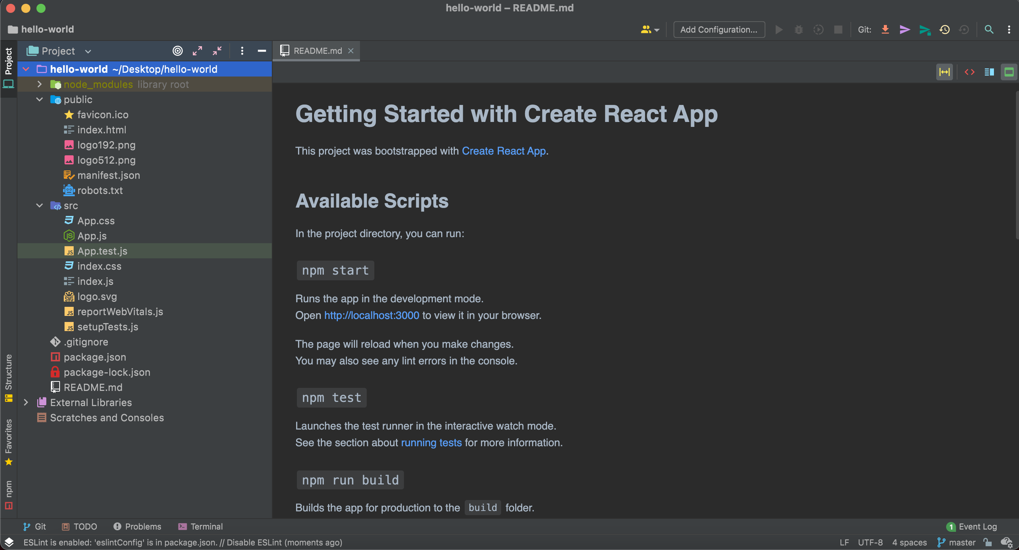

Slide 41
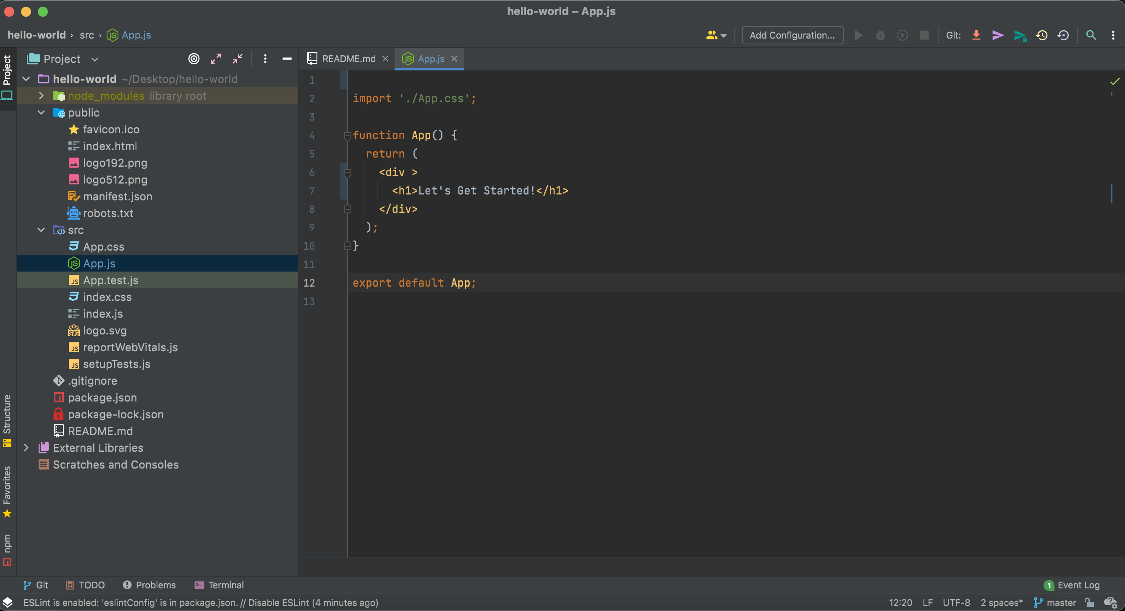

Slide 42
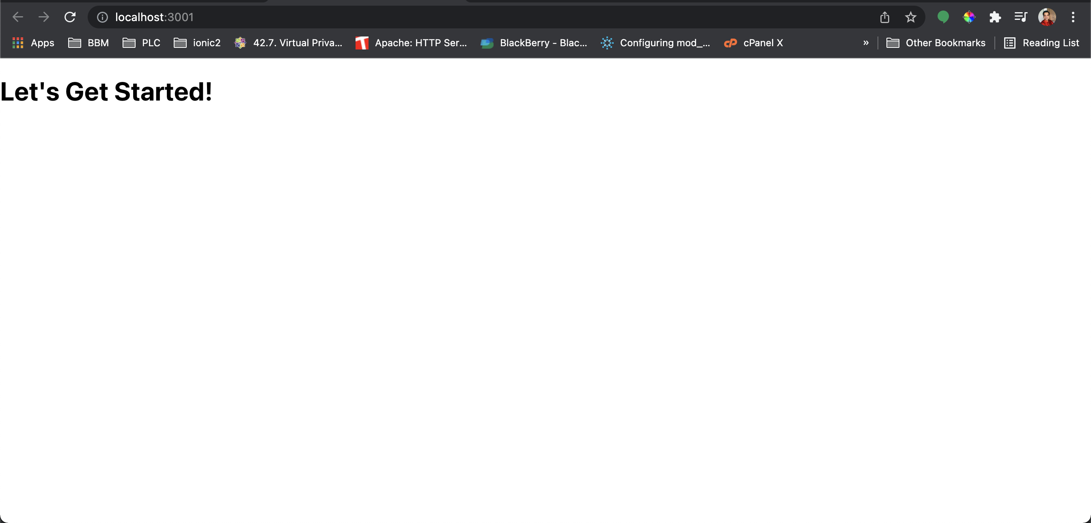

Slide 43
Analyzing Code

Slide 44
Delete these files

Slide 45
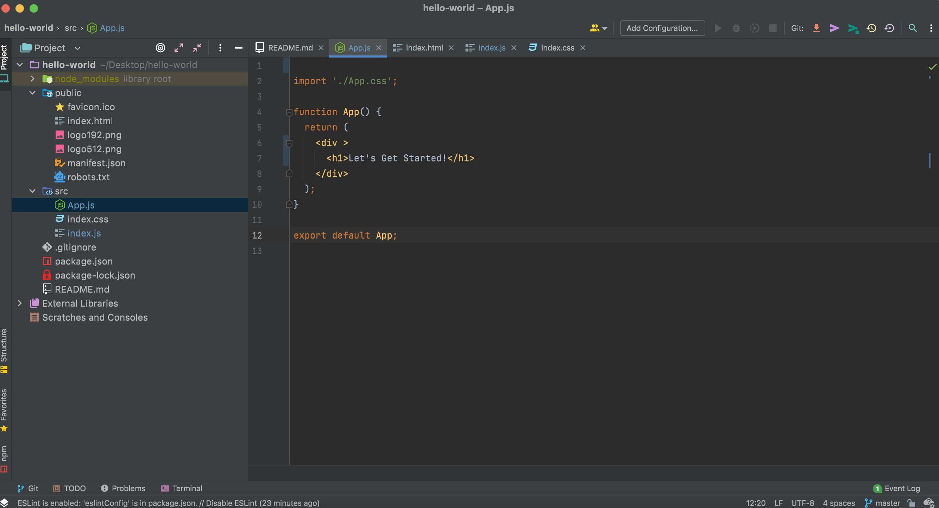

Slide 46
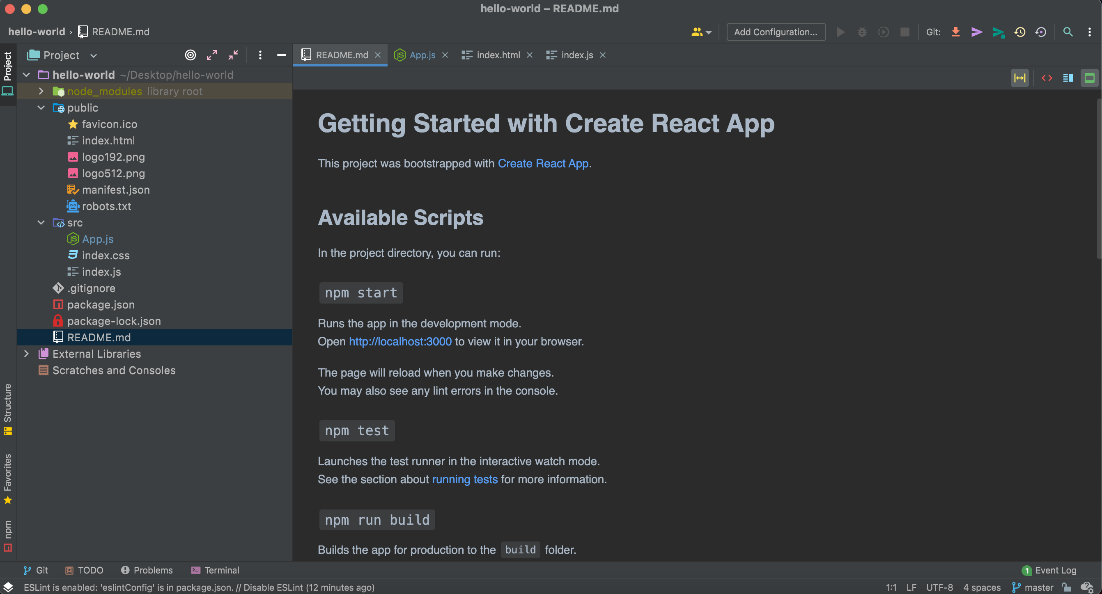

Slide 47
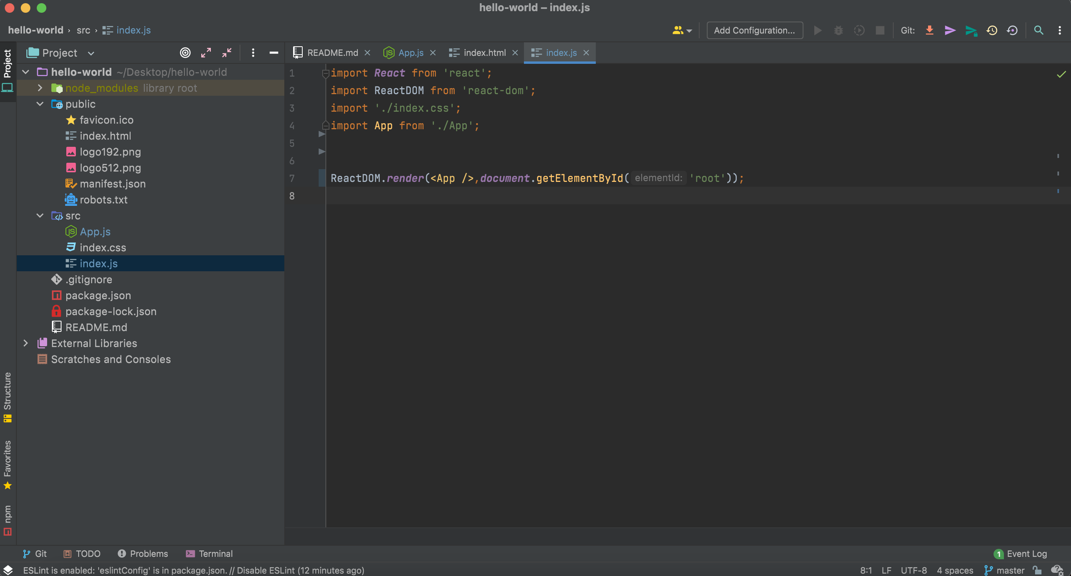

Slide 48
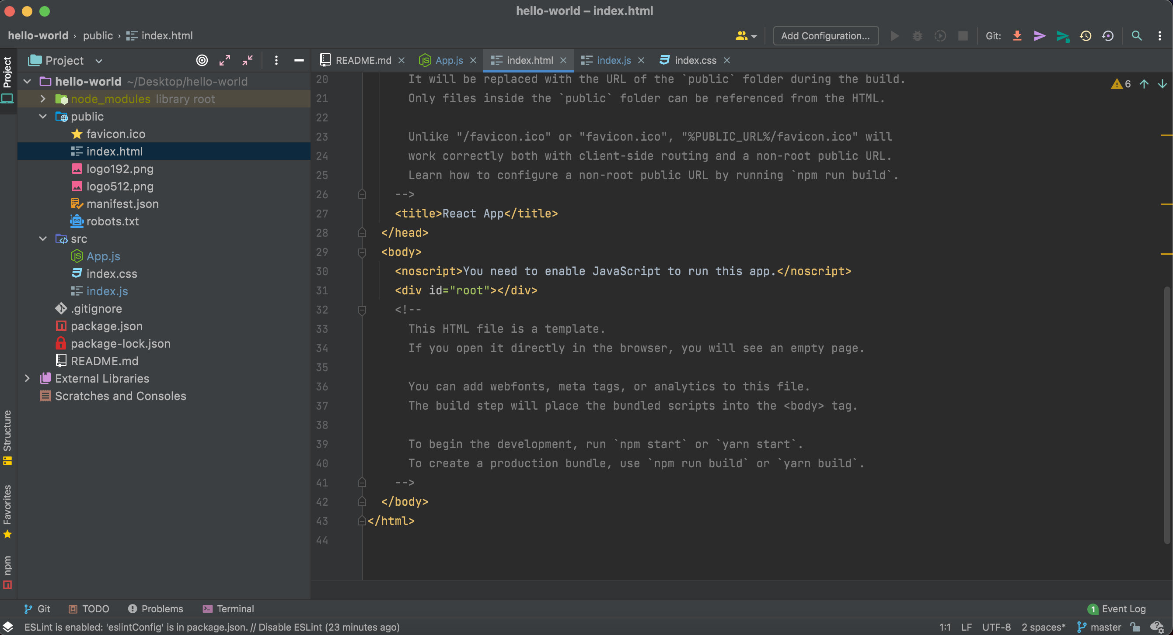

Slide 49
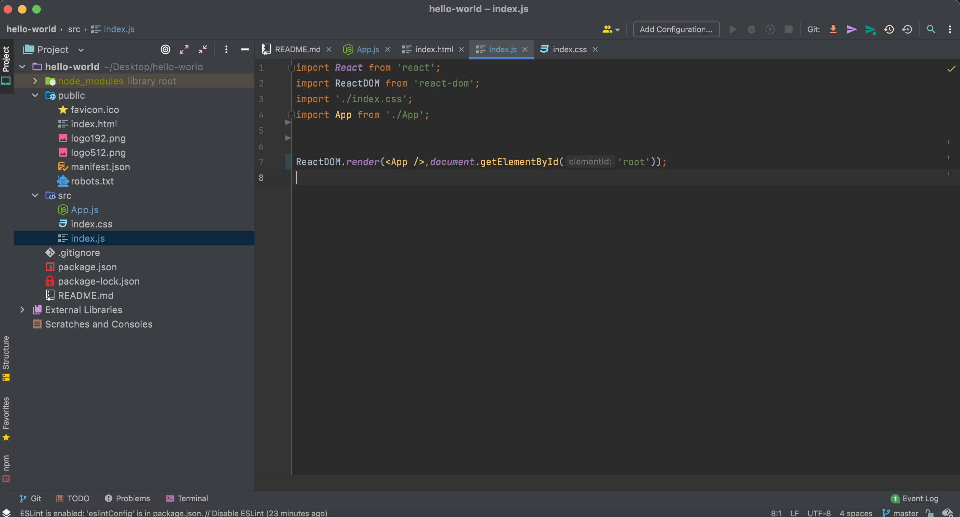

Slide 50
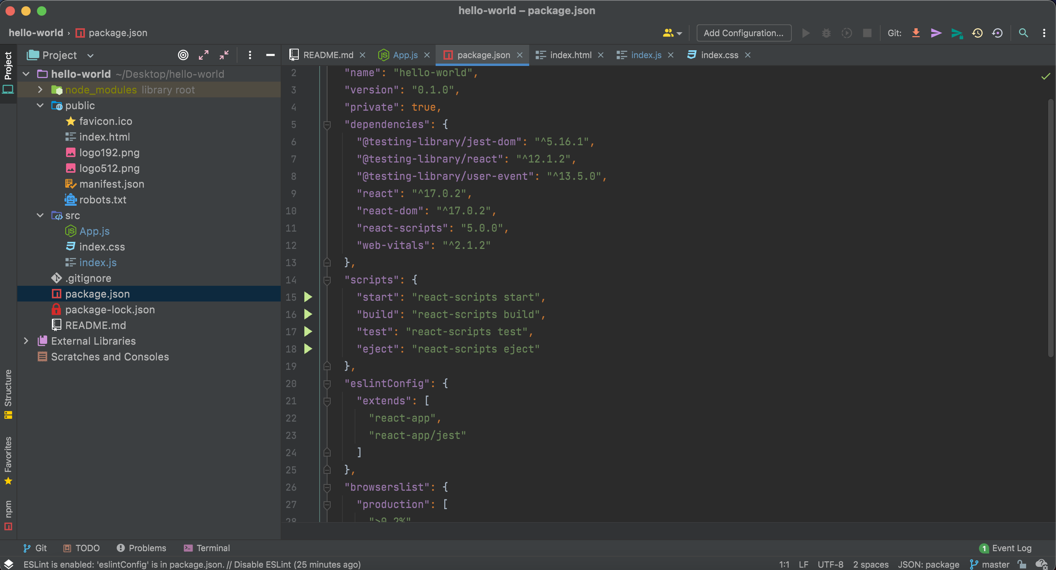

Slide 51
Example

Slide 52
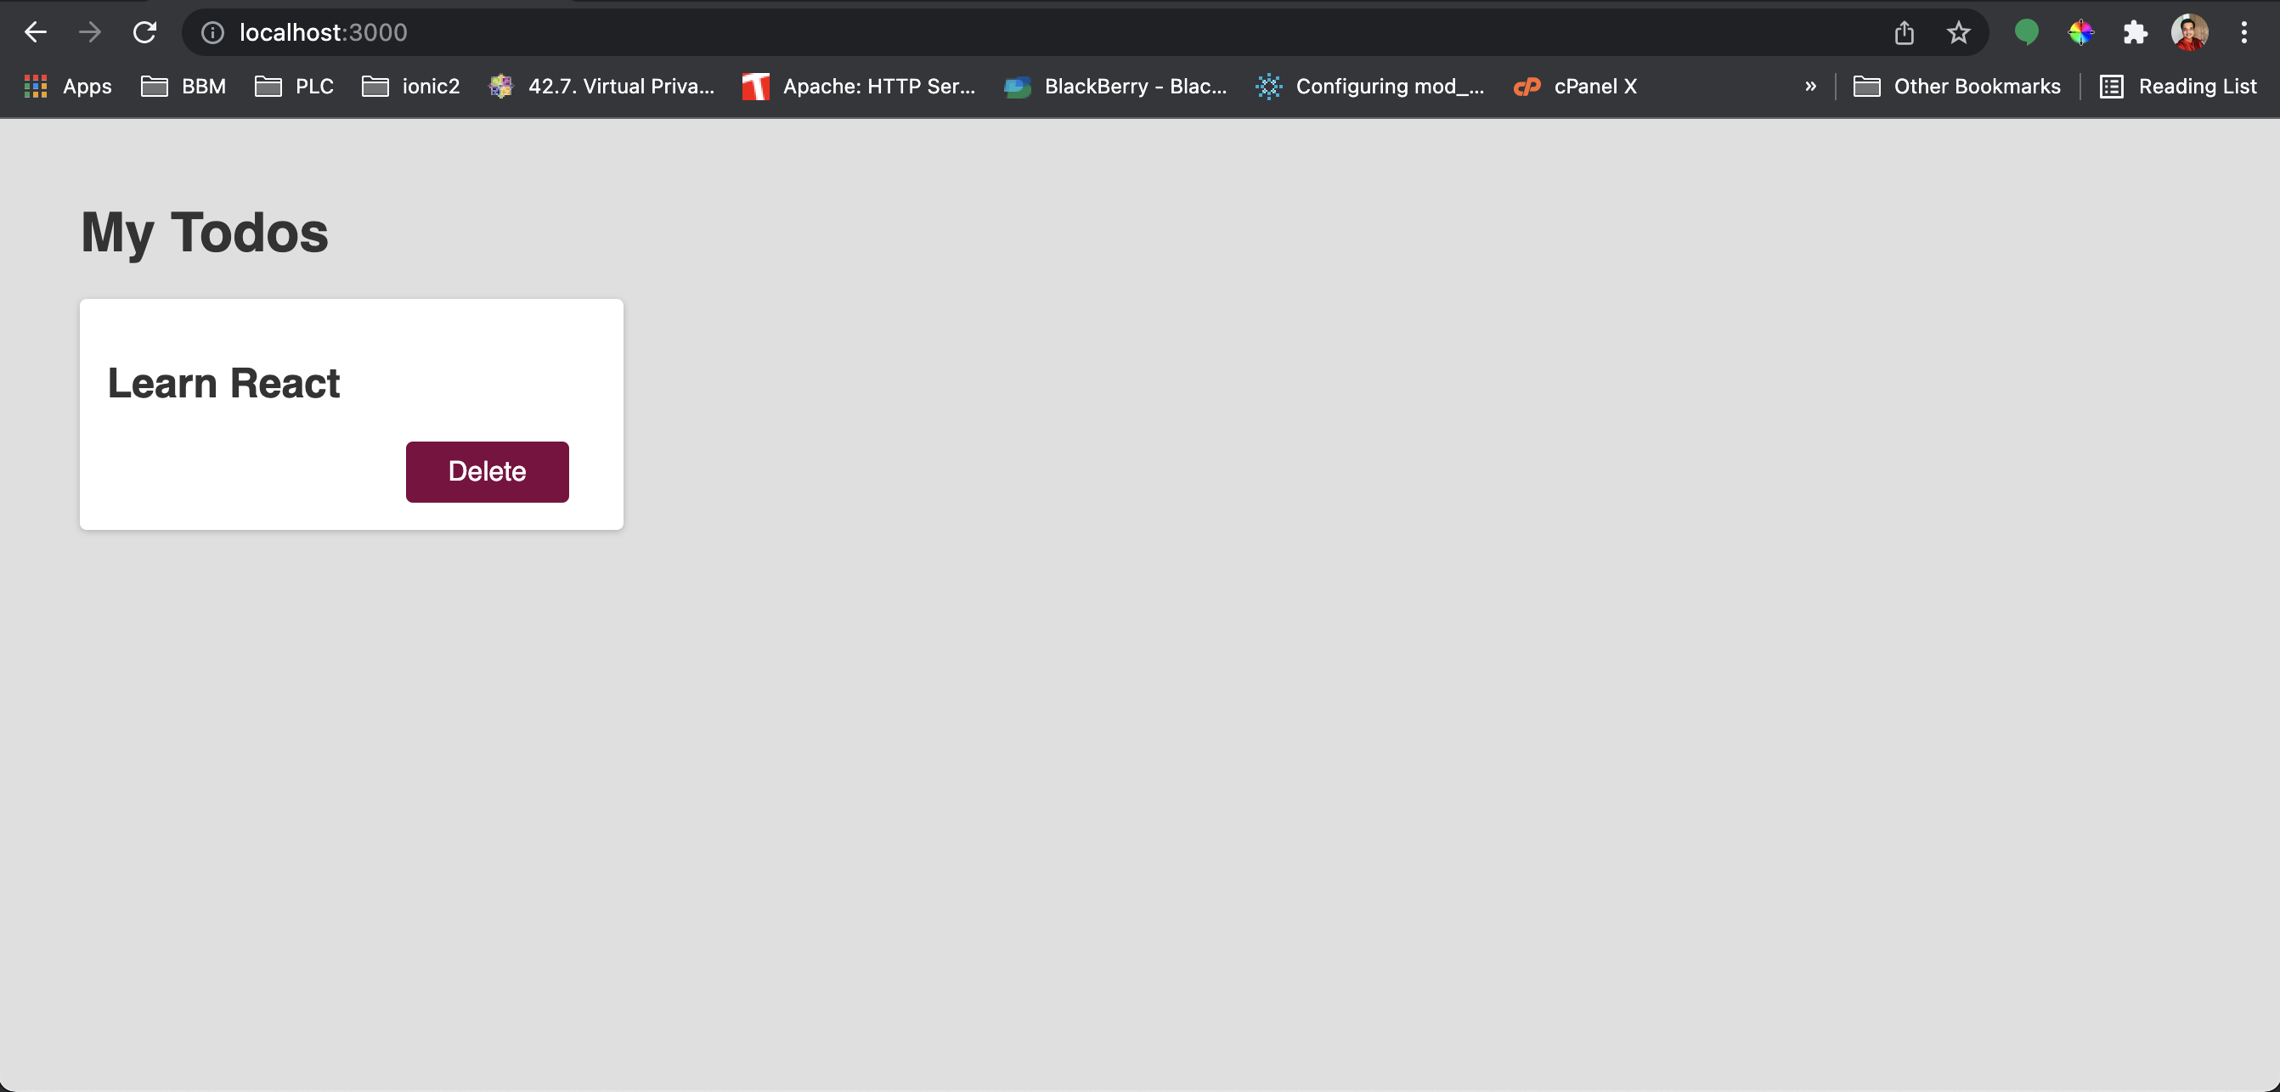

Slide 53
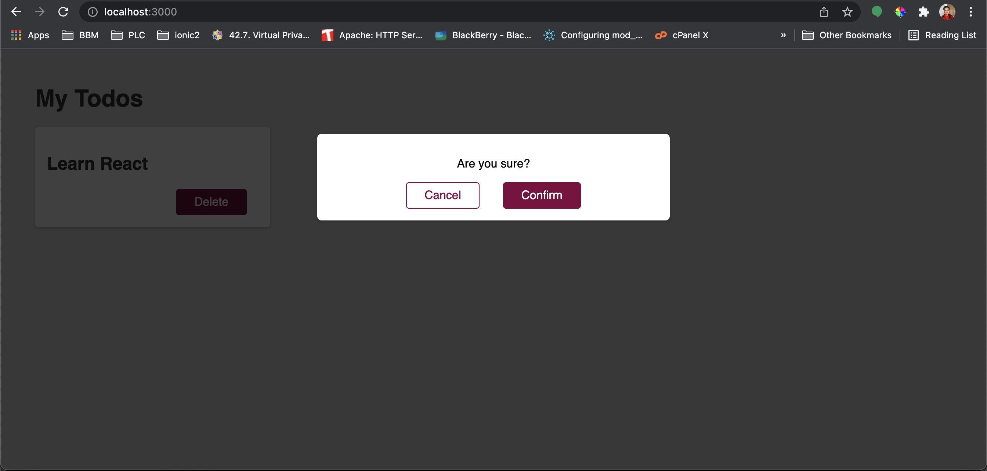

Slide 54
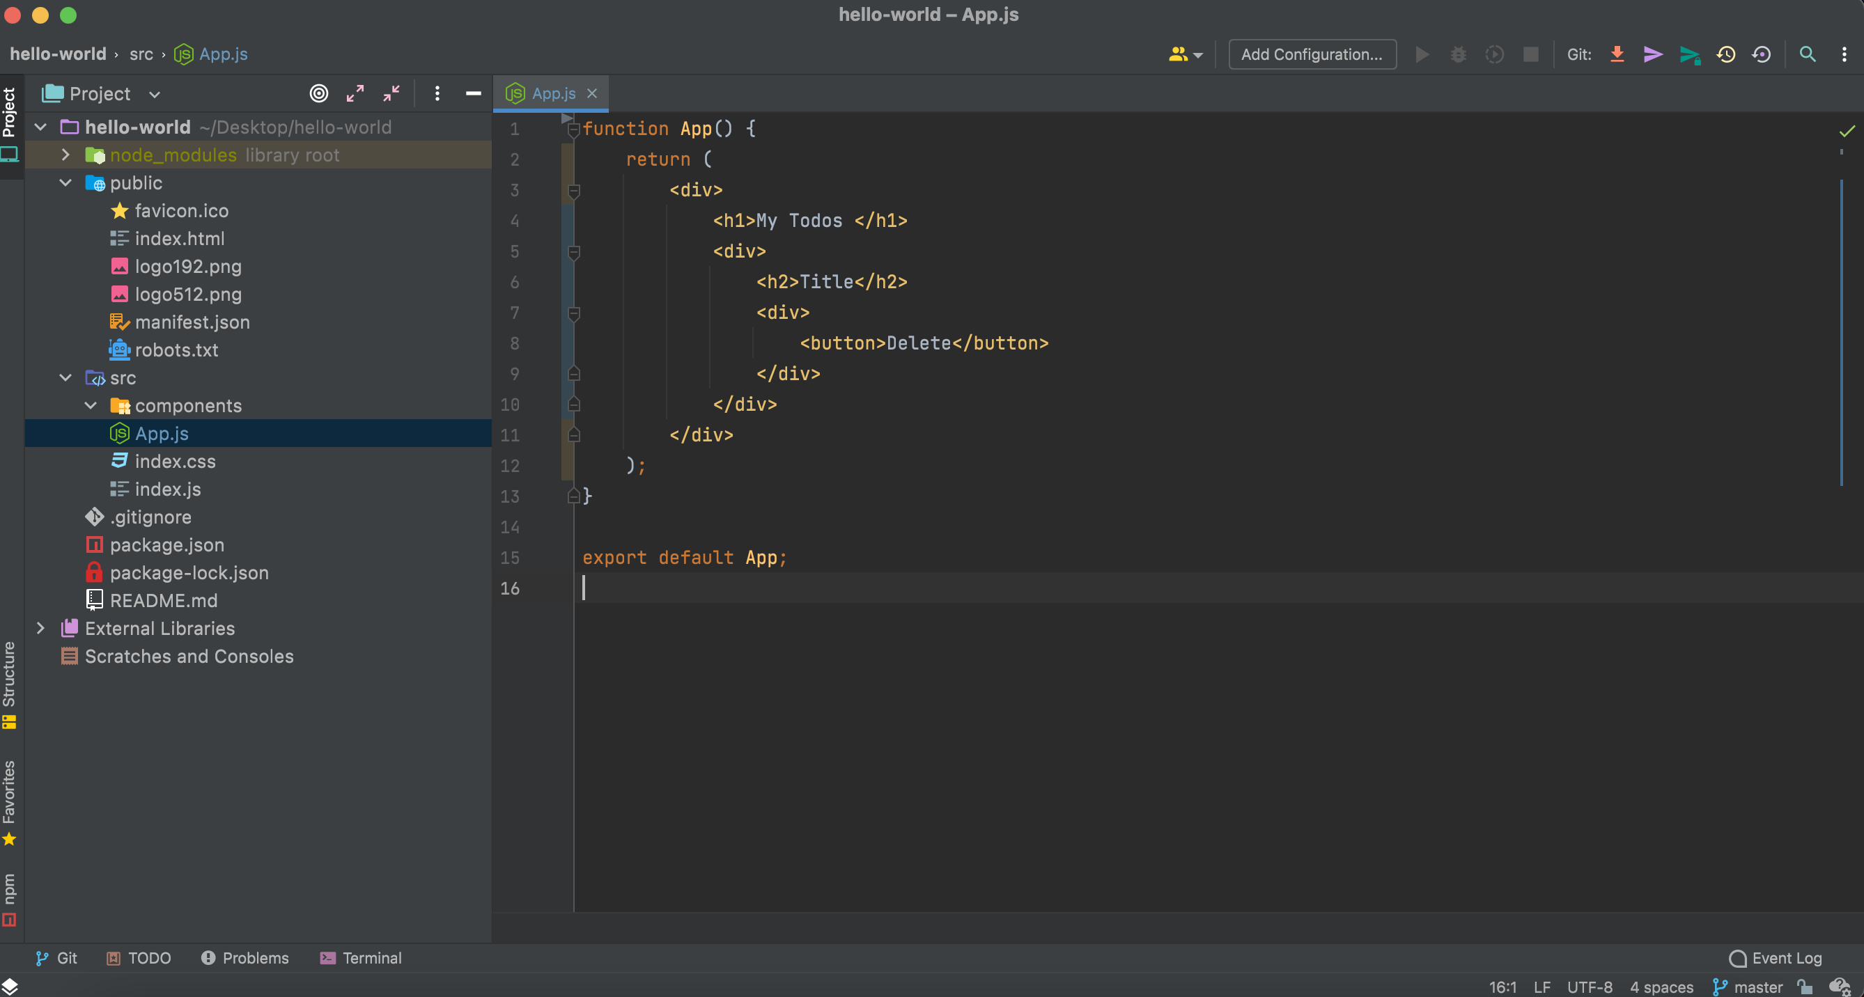

Slide 55
Output

Slide 56
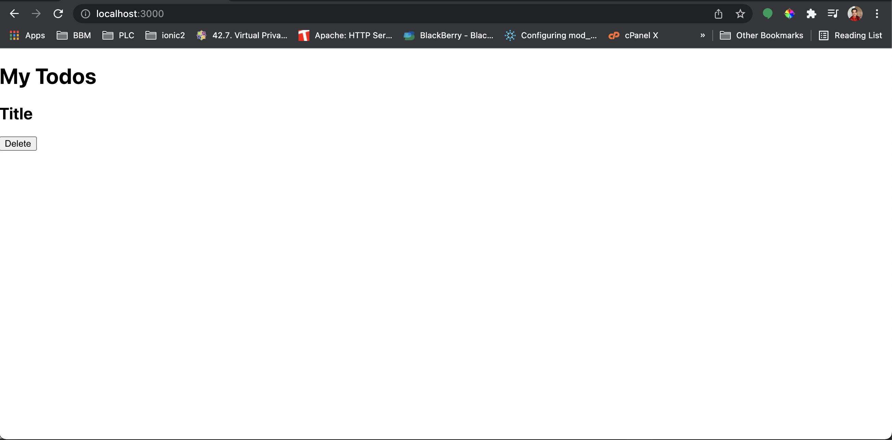

Slide 57
Lets update the index.css file

Slide 58
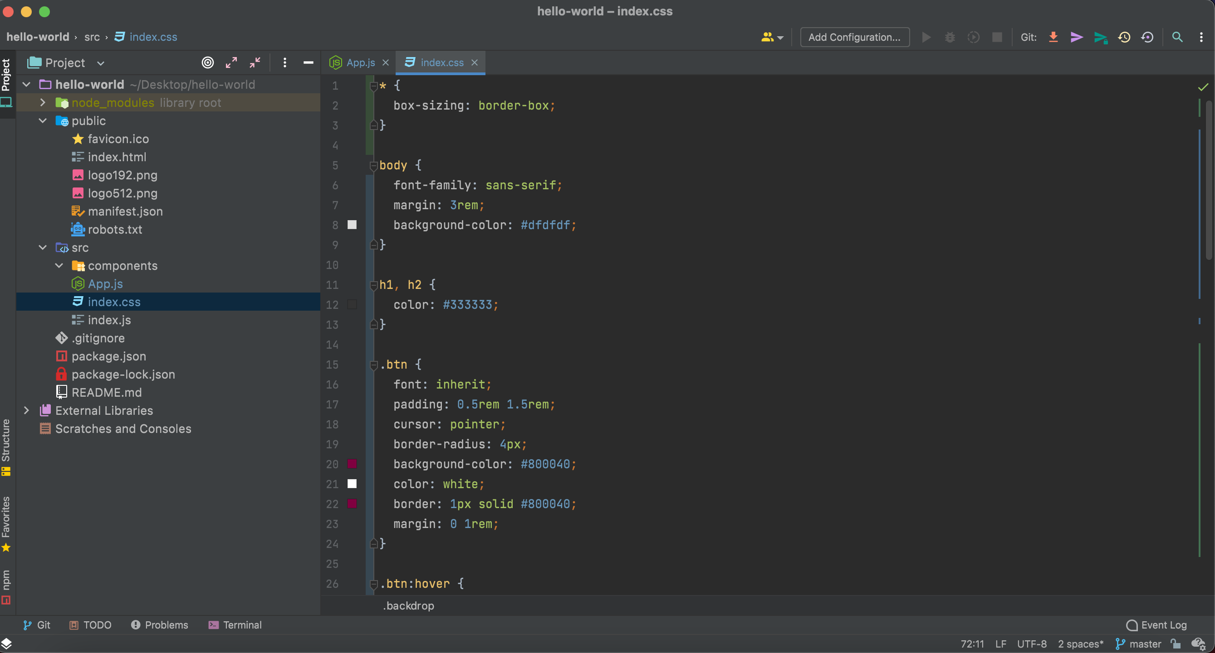

Slide 59
Output

Slide 60
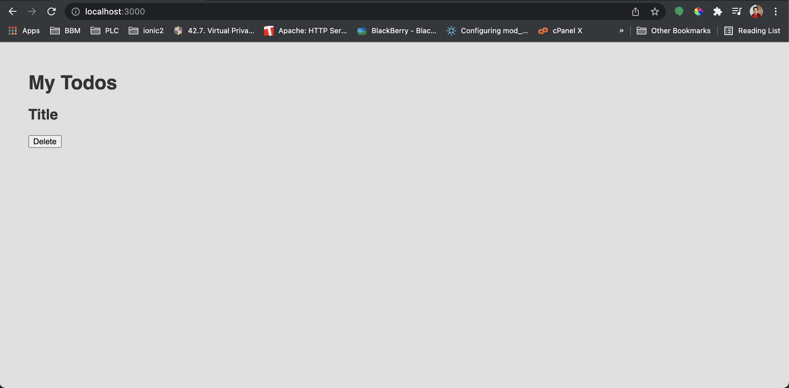

Slide 61
Let’s add some classes to our div

Slide 62
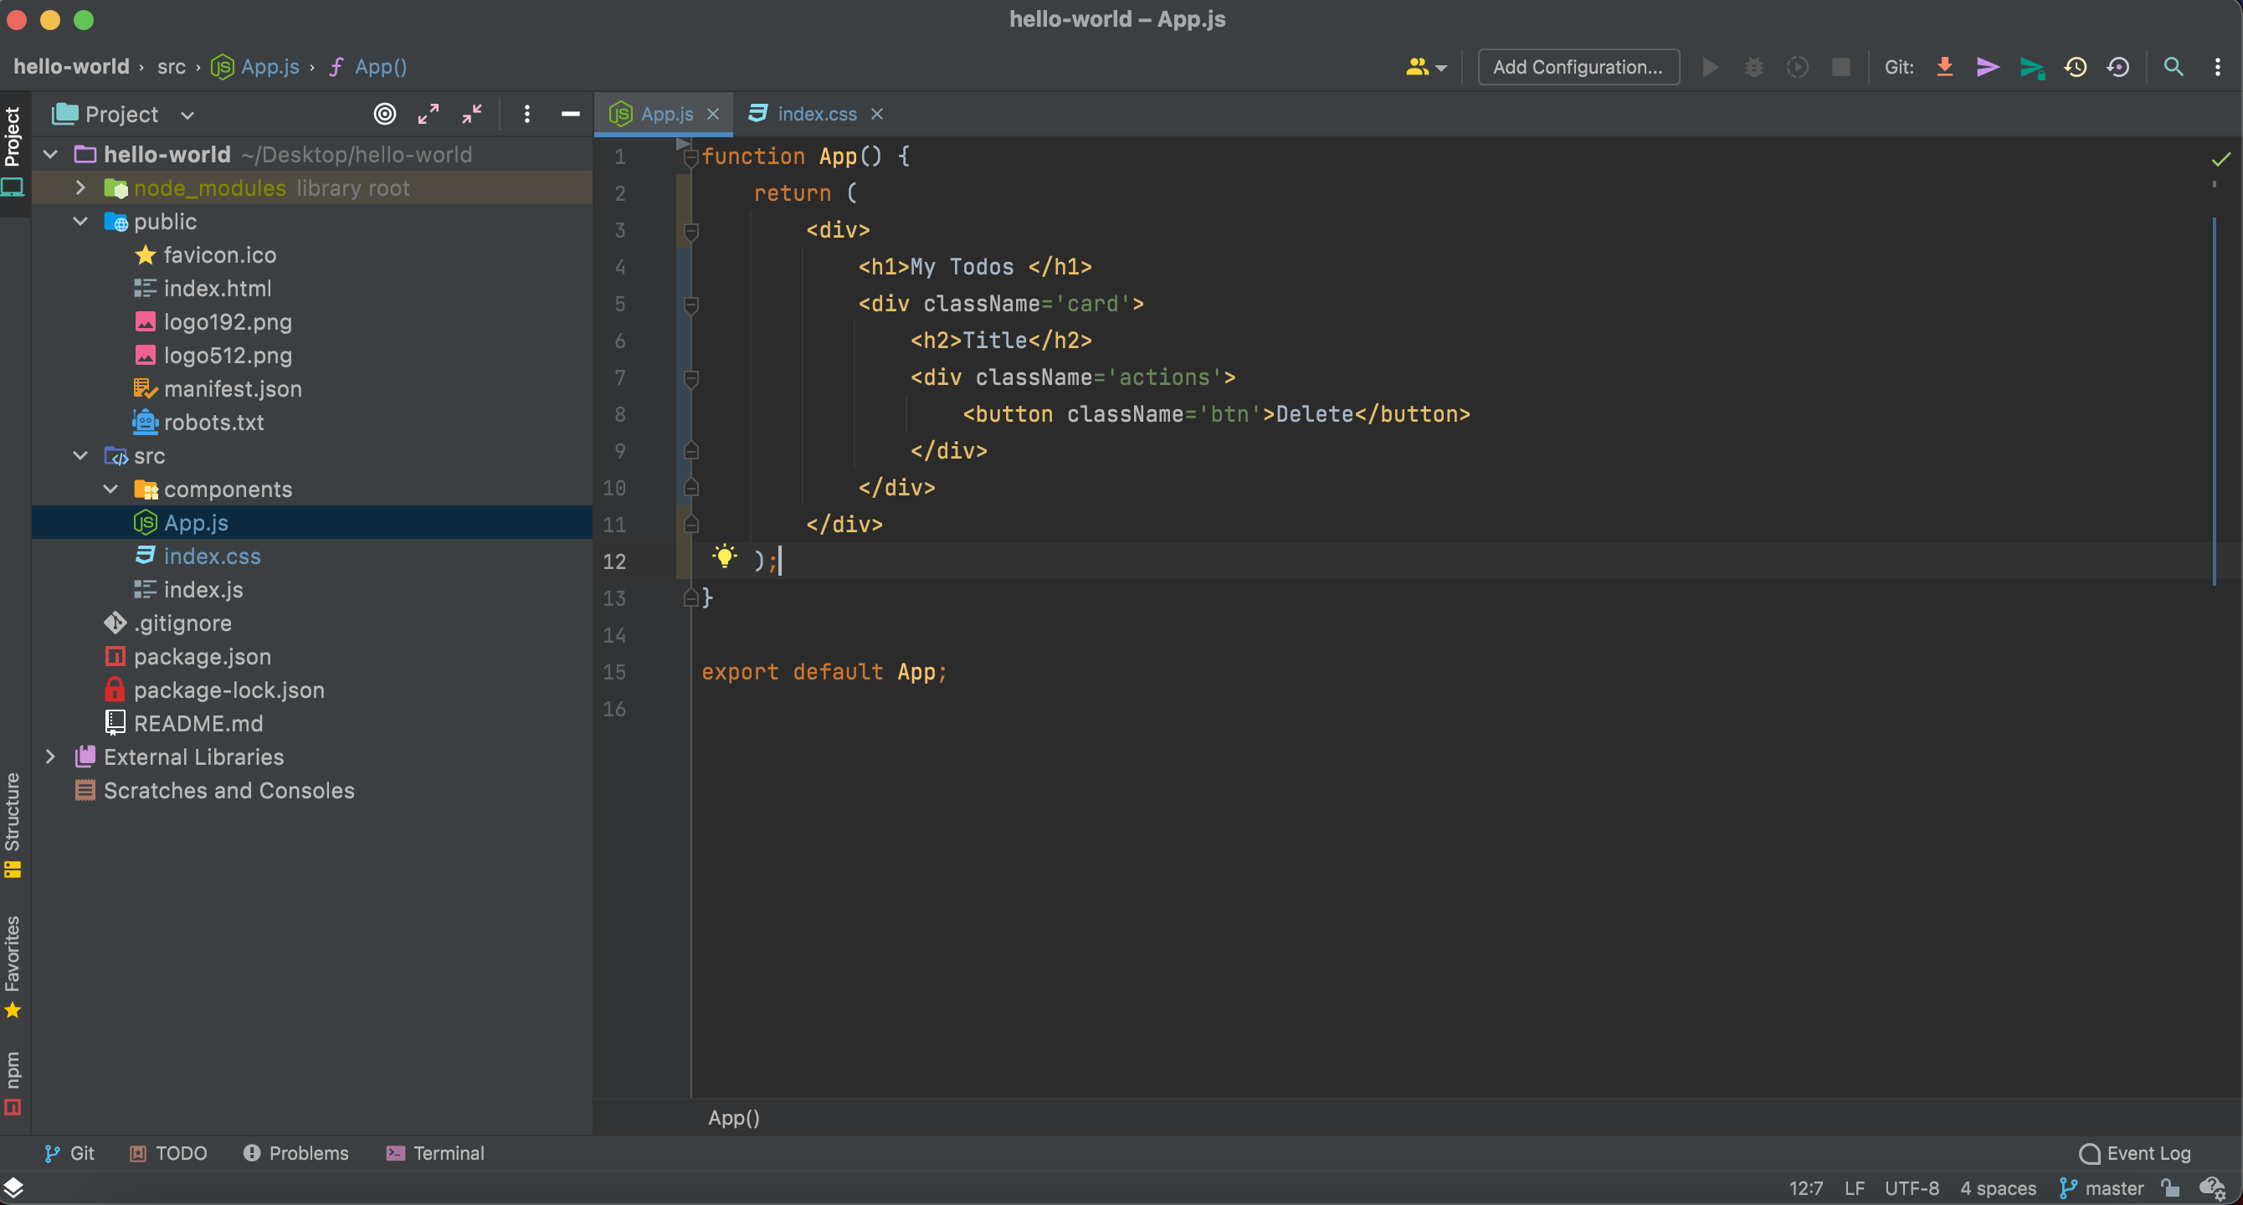

Slide 63
Output

Slide 64
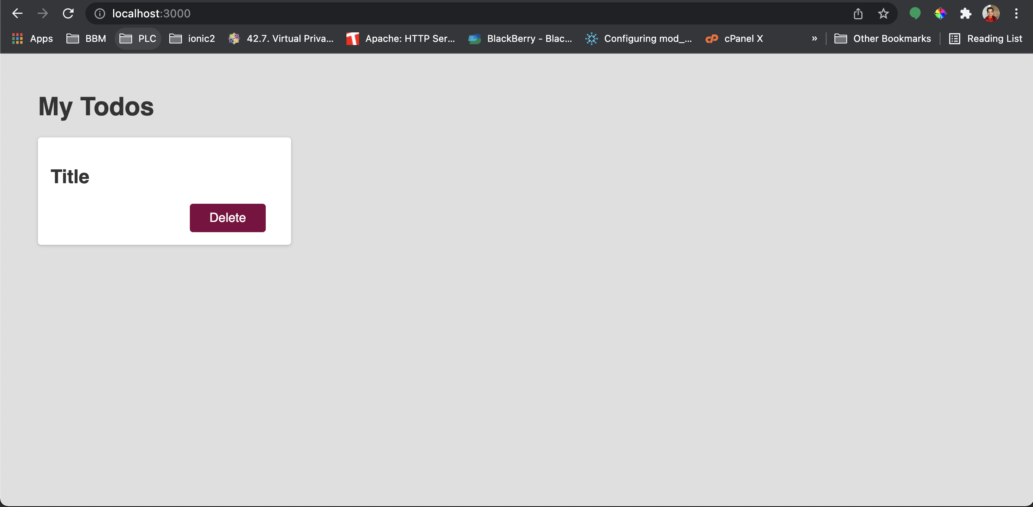

Slide 65
We can convert it to a component

Slide 66
Let’s create a Todo Component

Slide 67
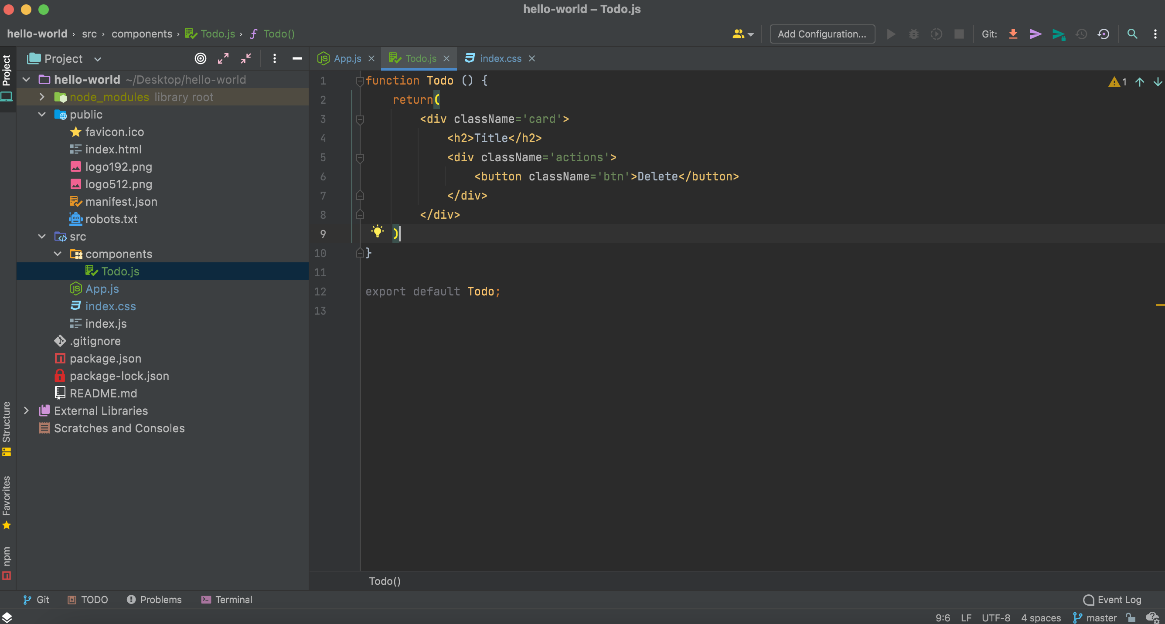

Slide 68
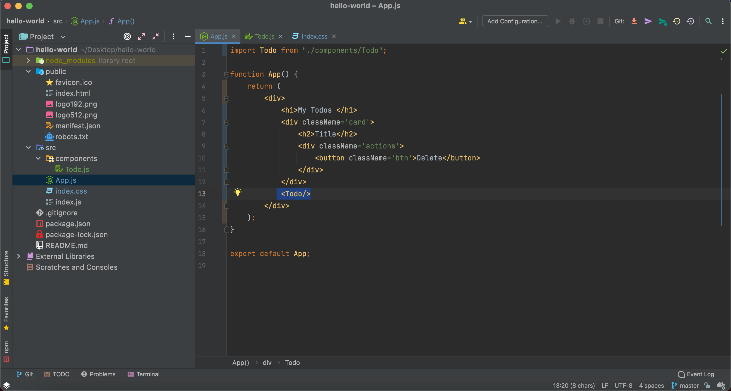
We can remove this section later

Slide 69
Output

Slide 70
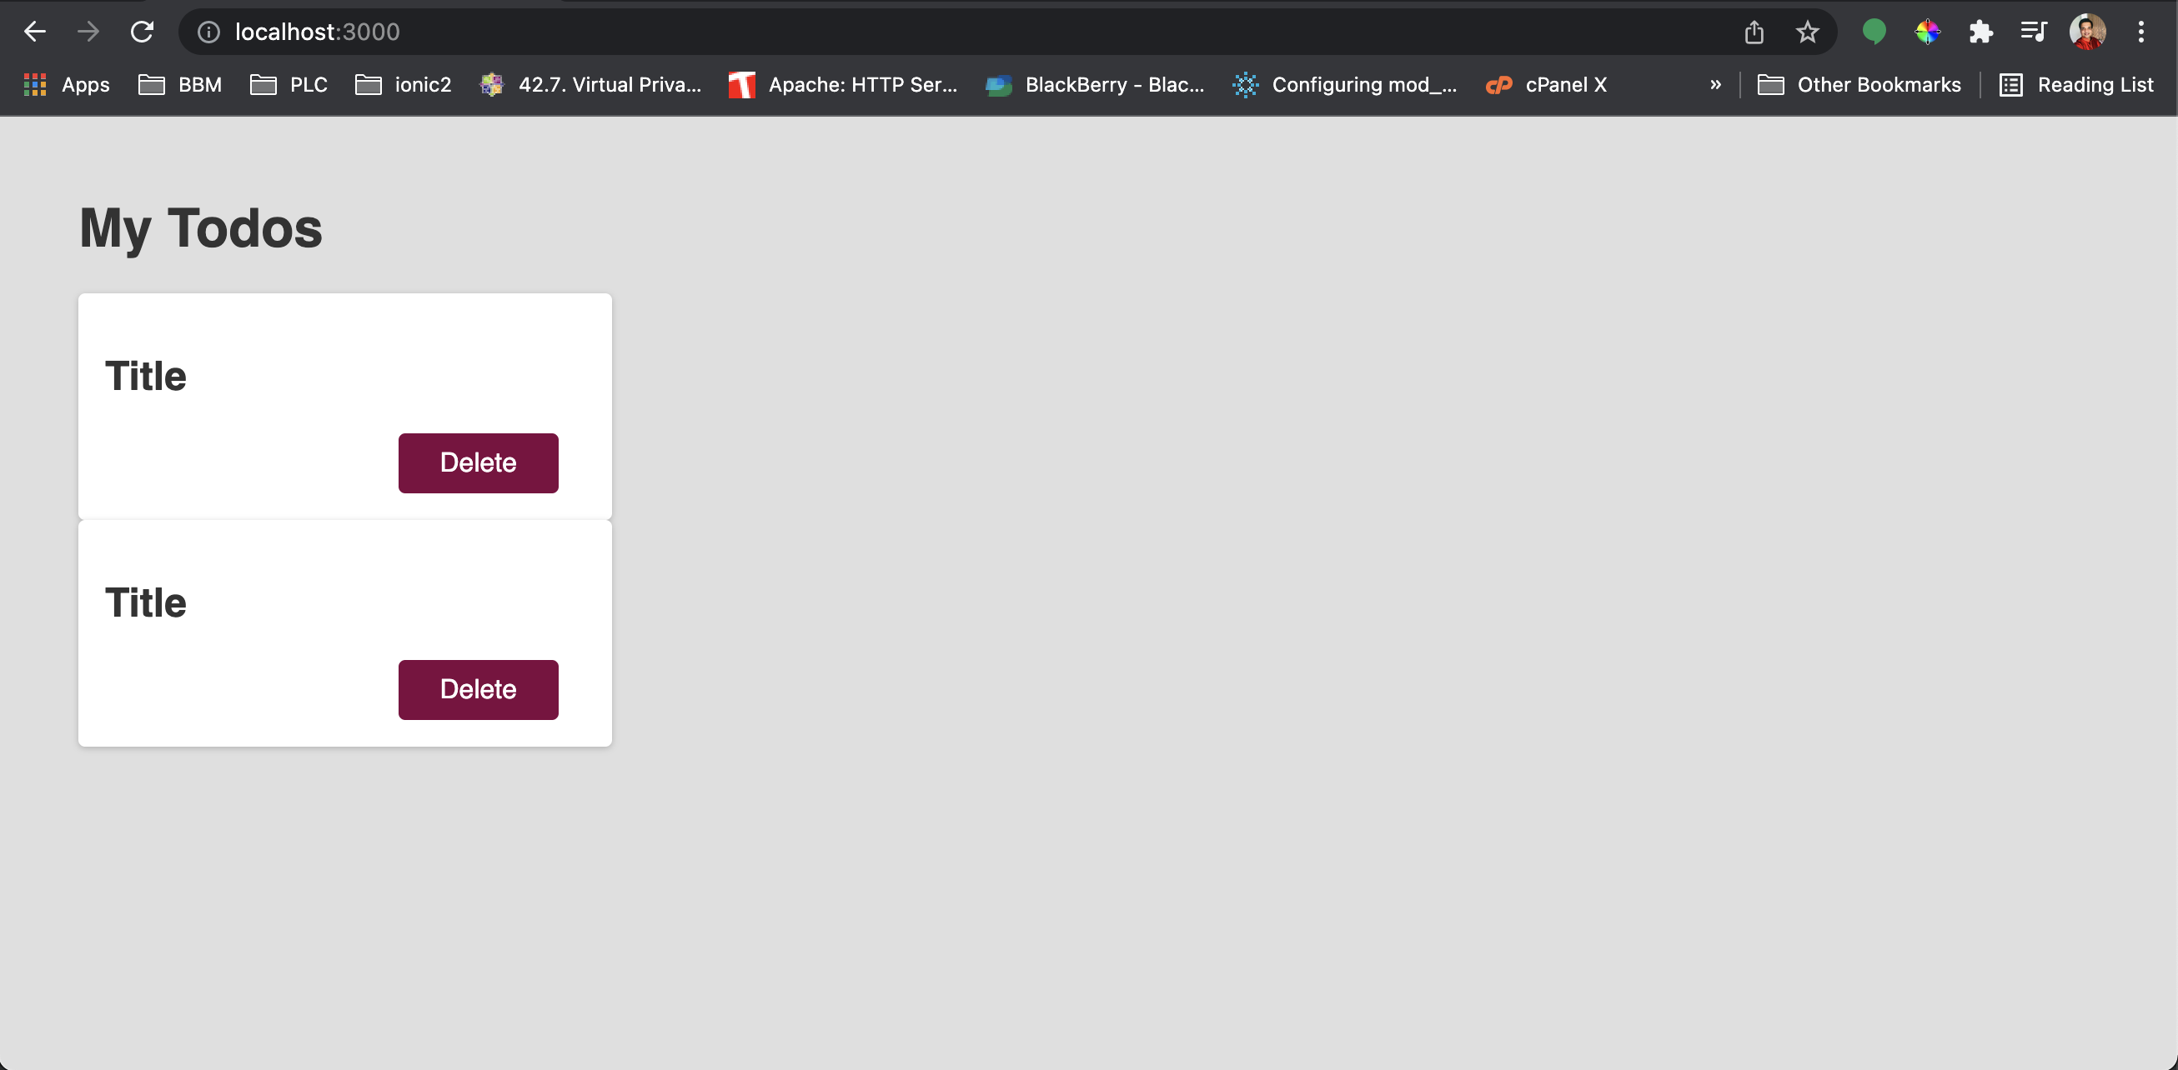

Slide 71
Working with props and dynamic content

Slide 72
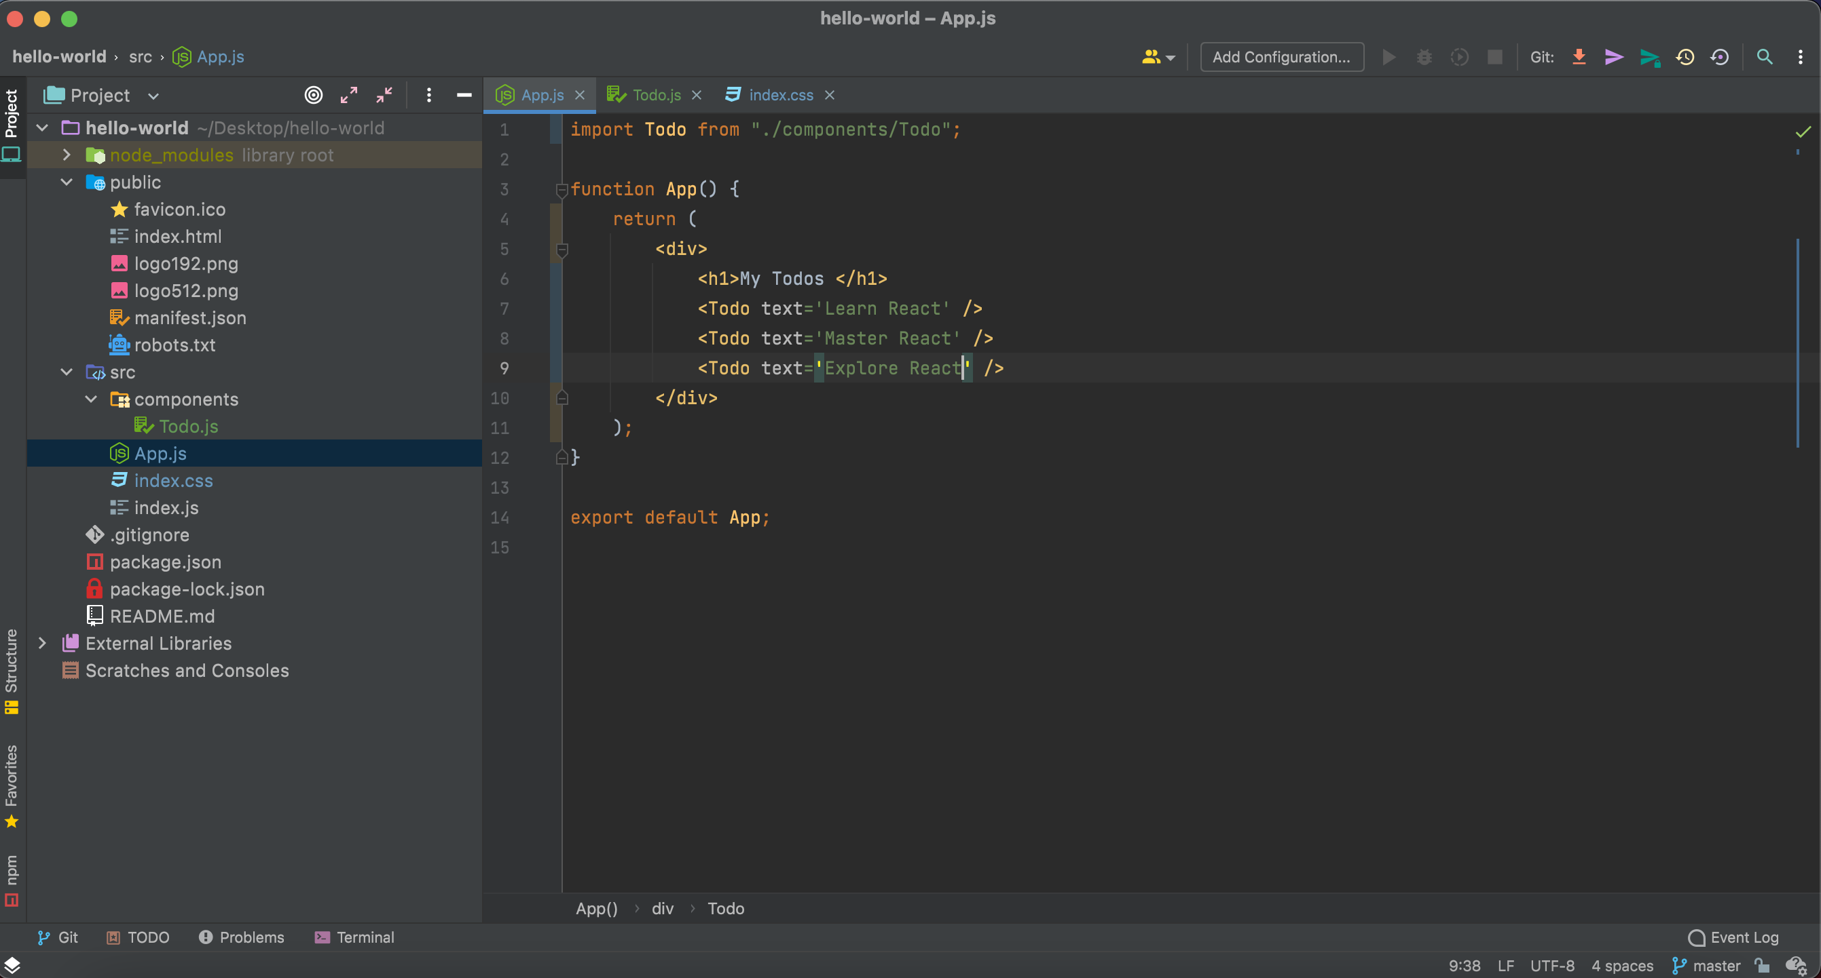
Add a text props to To-do Component

Slide 73
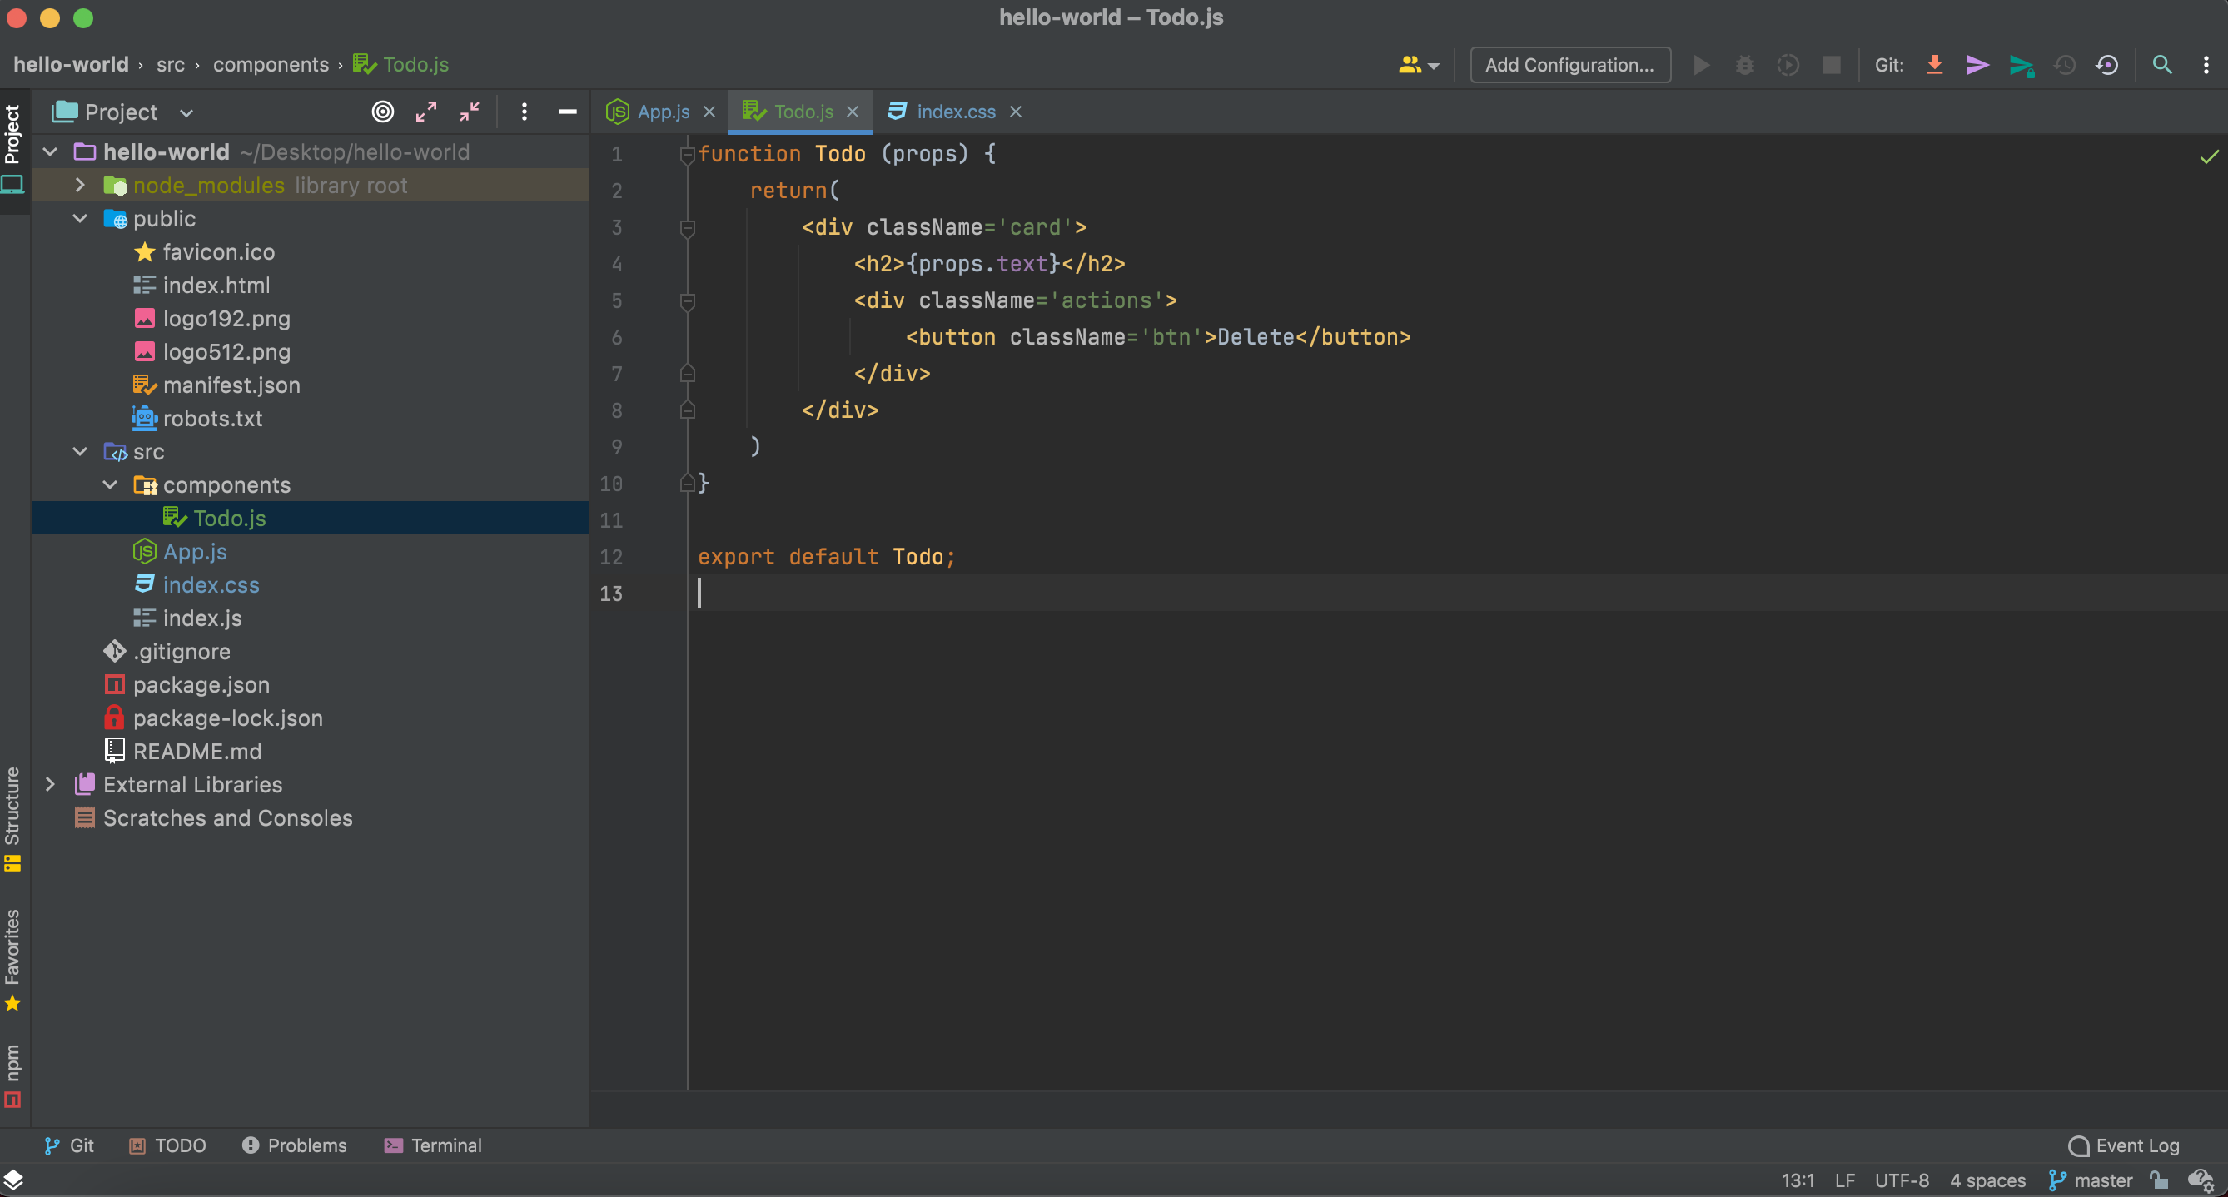
Add a text props to To-do Component

Slide 74
Output

Slide 75
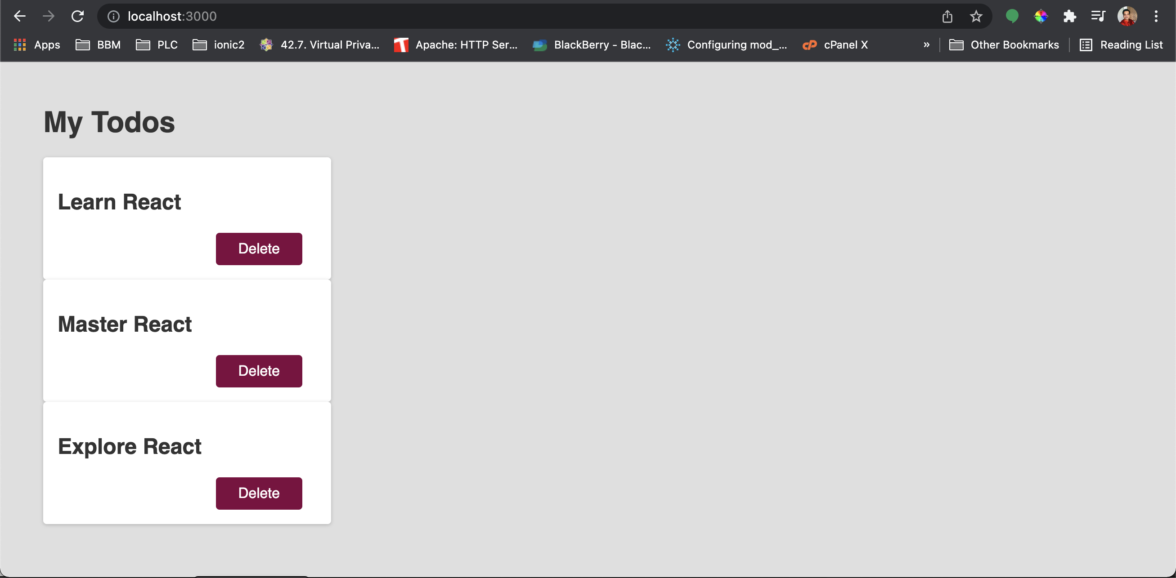

Slide 76
Handling Event

Slide 77
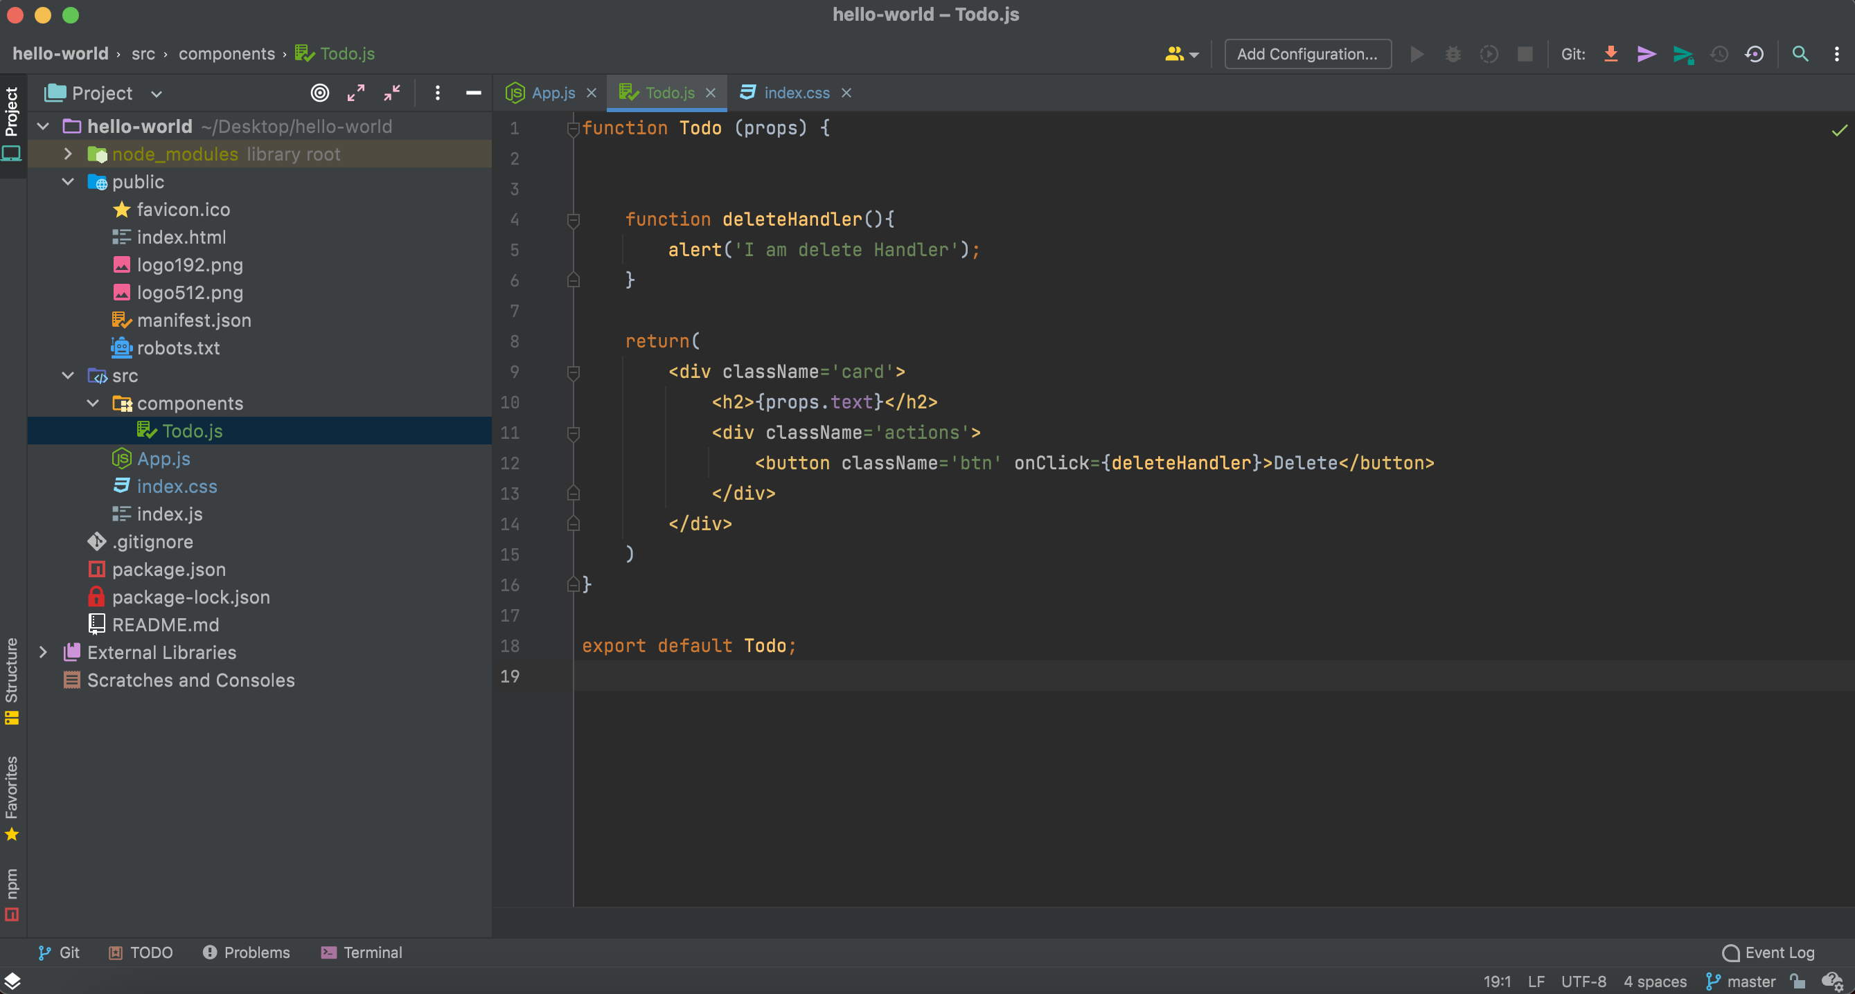
Add a new function and add onClick Event

Slide 78
Output

Slide 79
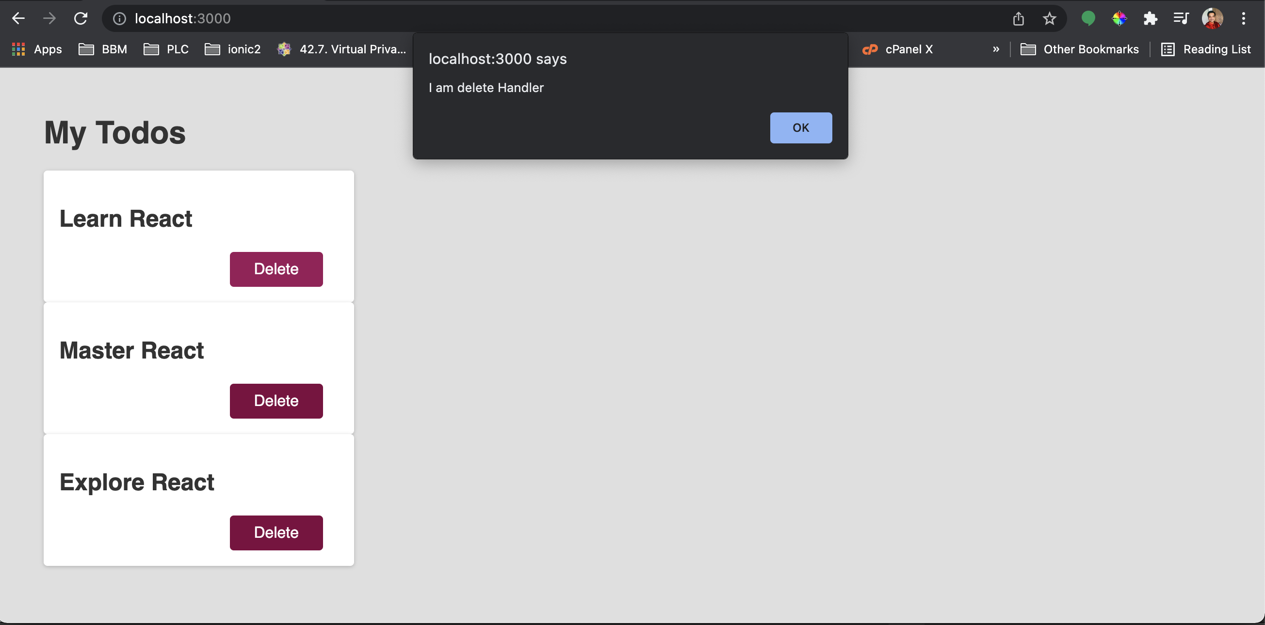

Slide 80
Adding More Component

Slide 81
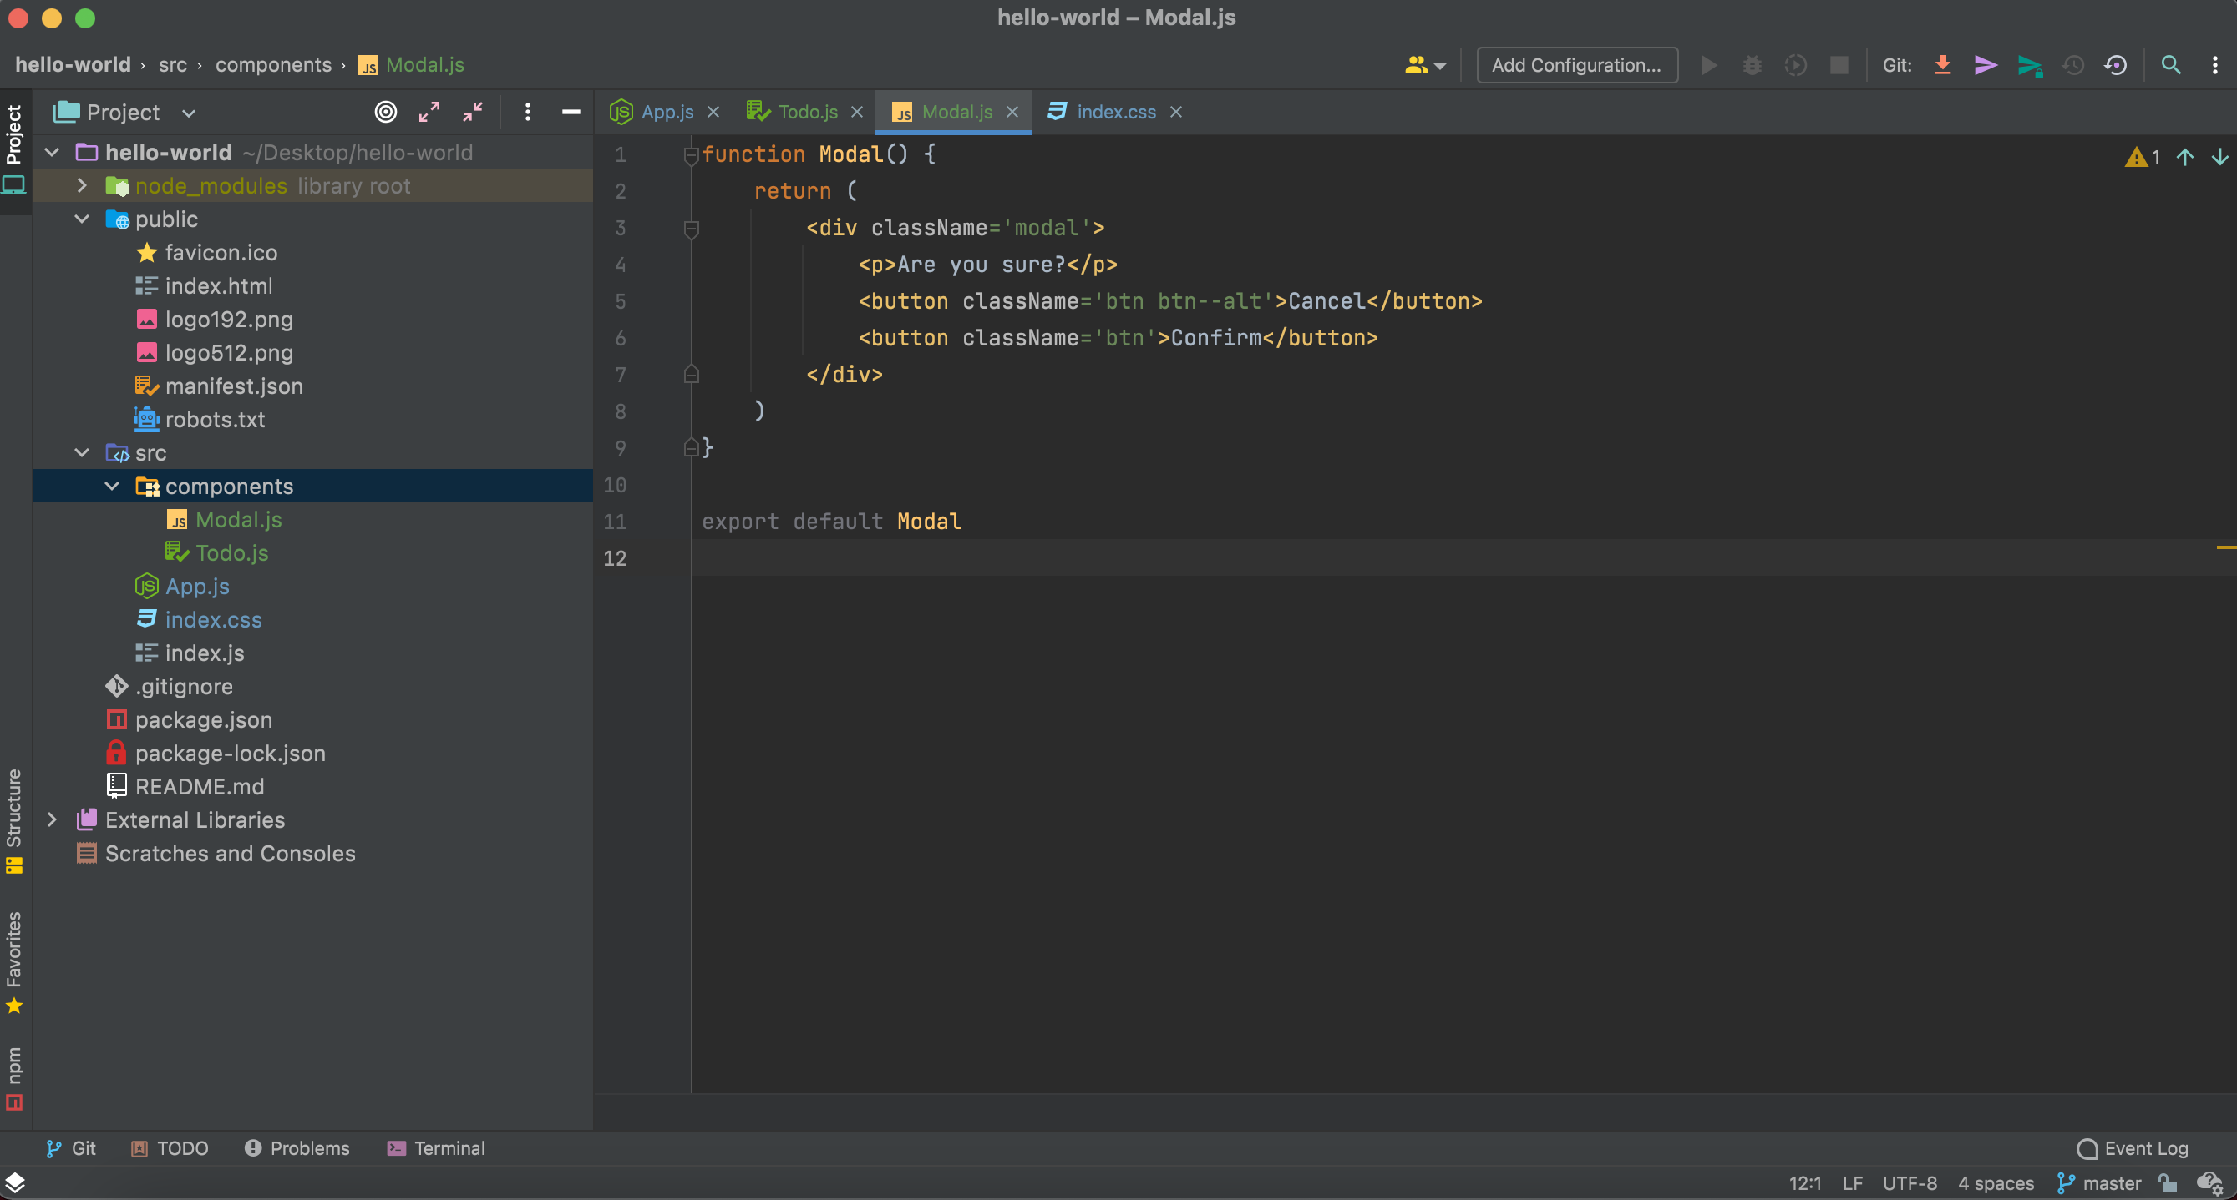
A new Modal Component

Slide 82
Let’s add a Backdrop Component for overlay for modal

Slide 83
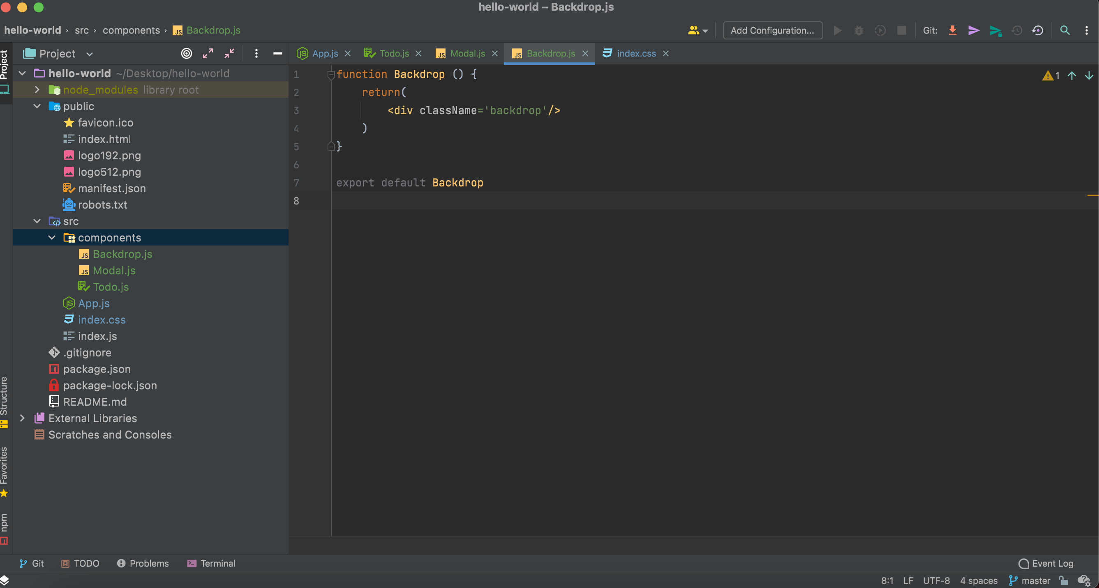
A new Backdrop Component

Slide 84

Adding new component to app.js

Slide 85
Output

Slide 86


Slide 87
How to use state?

Slide 88

Use of state variable

Slide 89
Working with “Events Props” (Passing Function as Props)

Slide 90

Reference to a function

Slide 91

Reference to a function

Slide 92

Reference to a function

